Slide 1
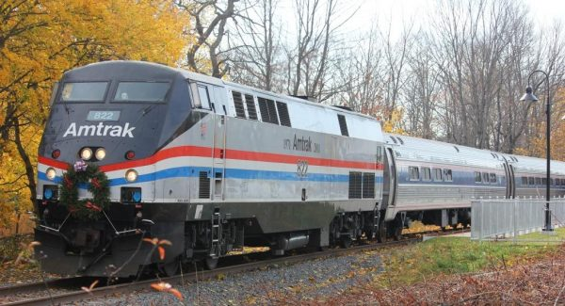
New England Regional
Service Proposal

Slide 2
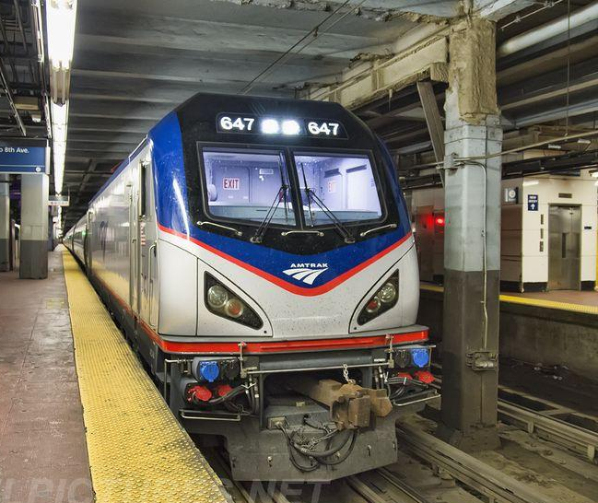
Introduction
Established in 1989 TrainRiders Northeast has brought federal, state, and local officials together with Amtrak and private railroads to expand and improve passenger rail service in the Northeast.

Slide 3
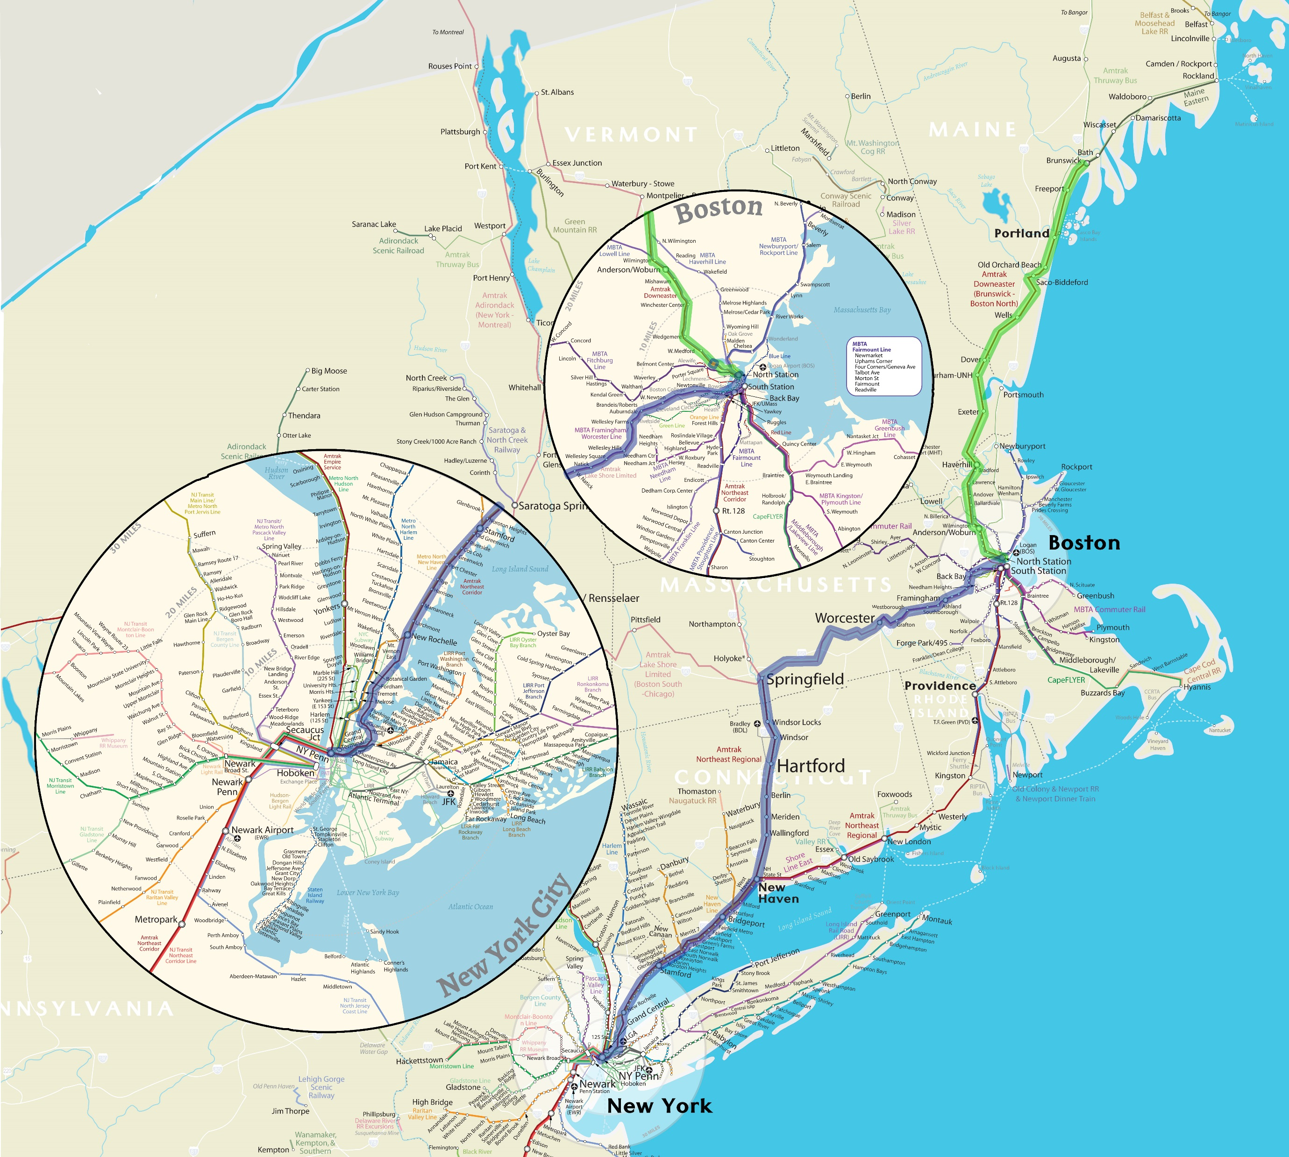
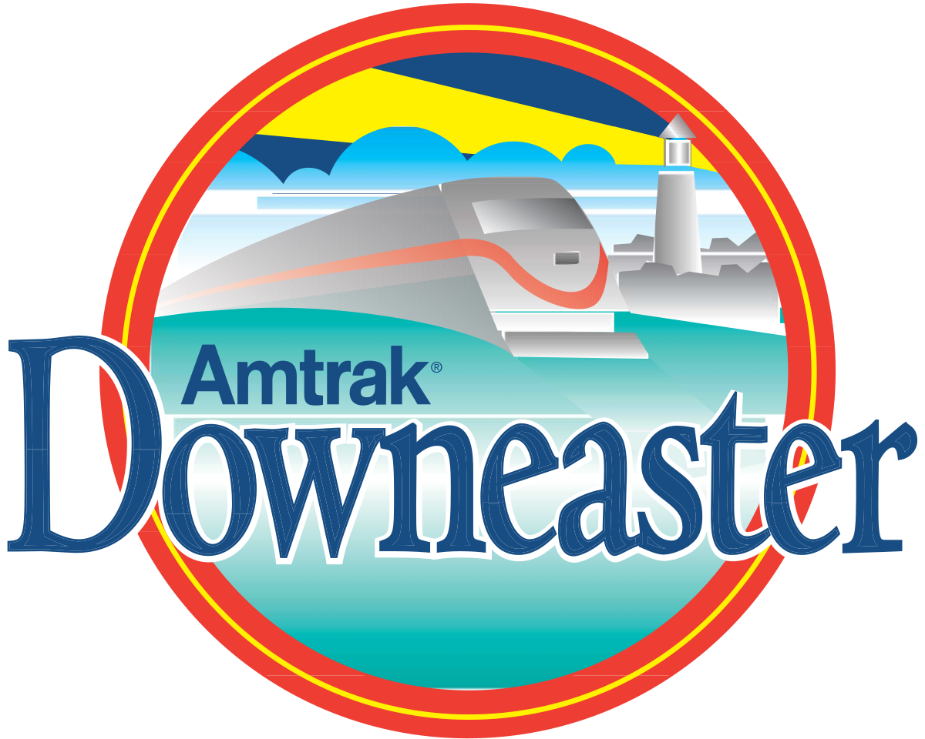
Introduction
Following the successful launch of the Downeaster service between Portland and Boston’s North Station in 2001, and the extension of that service to Brunswick, ME in 2013 , TrainRiders’ Board of Directors made a strategic decision to pursue the extension of passenger rail service to NYC via Worcester, Springfield, Hartford, and New Haven.

Slide 4
Background
In 2016, TrainRiders commissioned a ridership study and shared the results with Amtrak and the Northern New England Passenger Rail Authority (NNEPRA).
Later that year, at the request of TrainRiders and NNEPRA, Senator Susan Collins required Amtrak to conduct its own study of options to connect Maine, New Hampshire, and western Massachusetts with New York City.
The Amtrak report concluded that:
The service was justified based on expected demand
A stop in Boston was necessary for success
The required capital investment was a modest $13-$30 million.

Slide 5
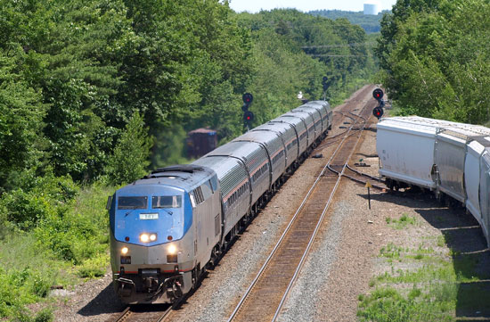
Background
TrainRiders ongoing discussions with stakeholders have significantly shaped and impacted the proposal.
A cross platform transfer at North Station has emerged as the preferred option.
Service will run from Boston’s North Station through Worcester, Springfield, Hartford, and New Haven to NYC.

Slide 6
North Station / NY Service
New England States is our suggested route branding for the service running from Boston’s North Station to NYC Penn Station.
A guaranteed cross platform connection between New England States and the Downeaster will provide an immediate connection from Maine to NYC.
This new service option from Boston North Station to NYC will help relieve congestion at South Station and provide convenient service to NYC from Worcester, Springfield, and points north and west of Boston.

Slide 7
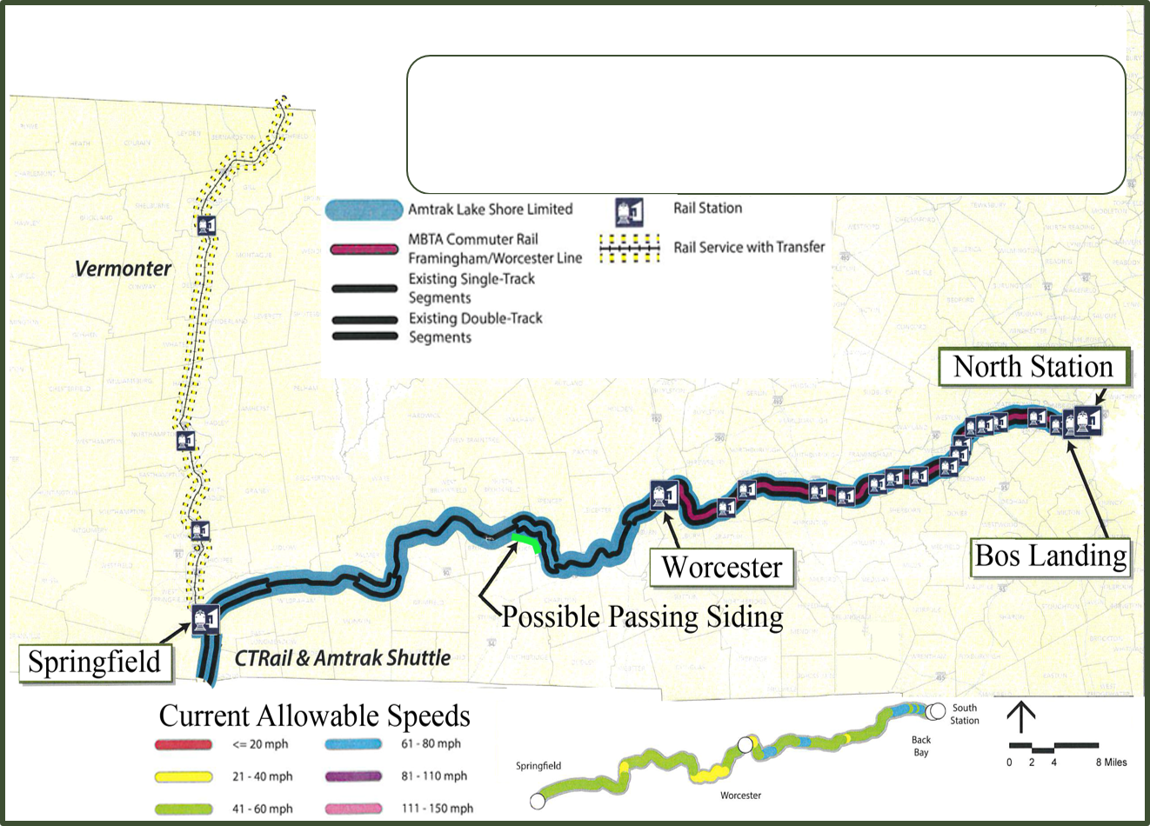
North Station to Springfield Route
and Improvements
Potential route upgrades:
Passing Sidings
Signal improvements
Track speed improvements
Springfield to NYC has undergone many major route improvements in the past ten years and will require minimal to no capital investment.
Existing Rail Service
SPG – BOS Rail service via Amtrak Lake Shore Limited
WOR – BOS Rail service via MBTA Commuter Rail
SPR – BOS CSX freight operations

Slide 8
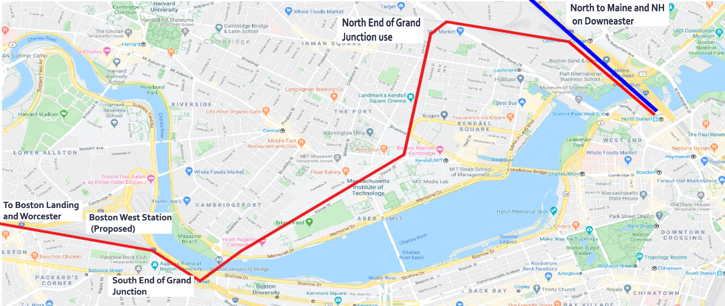
North Station and Grand Junction Vicinity

Slide 9
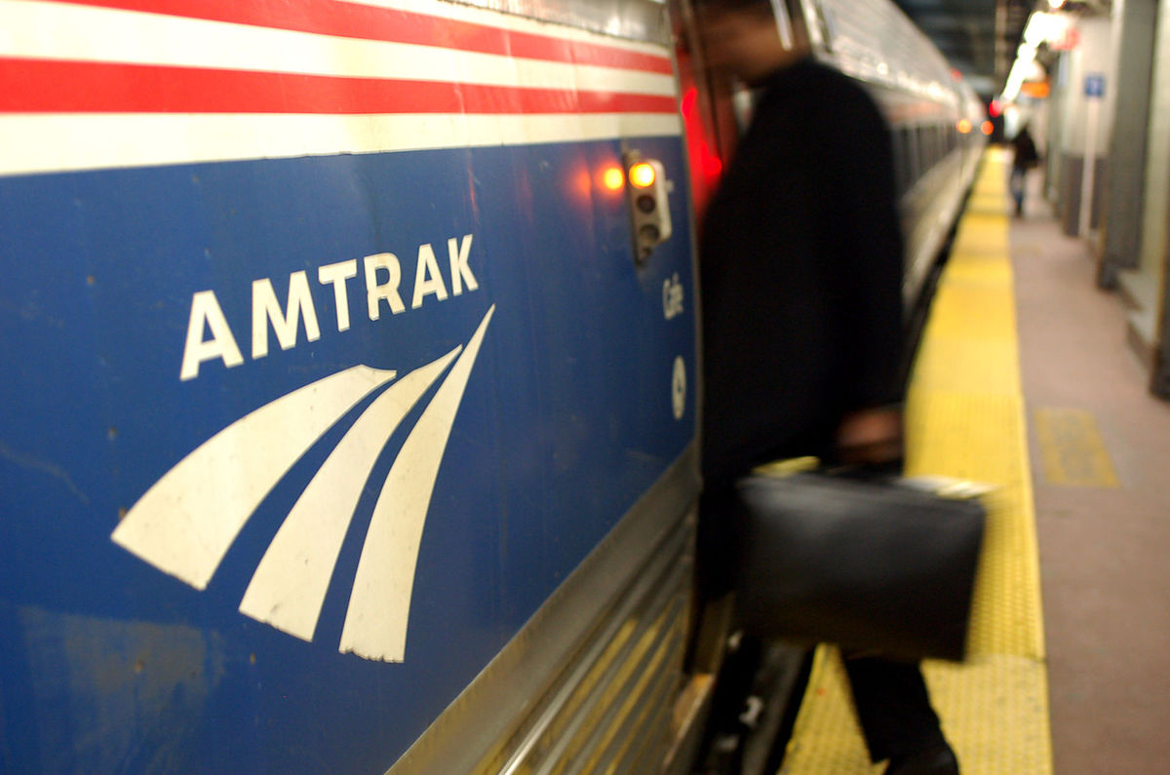
New England States Service Benefits
North Station /NYC service will provide travel opportunities and economic benefits on a truly regional basis to communities in five different states.
It will enhance existing services between Springfield and NYC by providing additional daily trips, while also satisfying unmet transportation needs in western Massachusetts.
Many segments on the proposed route have already been significantly improved for faster train speeds.
Service startup could occur within one construction season after funding approval.

Slide 10
New England States Suggested Stations
Boston Landing (BOL)
North Station (BON)
New Haven (NHV)
Framingham (FRA)
Boston West (BOW)
Bridgeport (BRP)
Worcester (WOR)
NEW YORK (NYP)
Palmer (possible)
Stamford (STM)
Springfield (SPG)
Hartford (HFD)
Boston West
NYP
STM
BRP
NHV
HFD
SPG
WOR
FRA
BON
NHV
BOW
BOL

Slide 11
New England States Running Times
Route Segment | Segment Distance | Route Mileage | Average Speed | Segment Time (h:mm) | Running Total (h:mm) | Initial Average Speed | Initial Running Time Total
North Station – Boston Landing | 5.1 | 5.1 | 32 | 0:09 | 0:09 | 32 | 0:09
Boston Landing - Framingham | 17.6 | 21.8 | 48 | 0:21 | 0:30 | 56 | 0:28
Framingham - Worcester | 22.8 | 44.6 | 36 | 0:38 | 1:08 | 60 | 0:51
Worcester - Springfield | 54 | 98.6 | 43.2 | 1:15 | 2:23 | 65 | 1:41
Springfield - Hartford | 26 | 124.6 | 50 | 0:31 | 2:54 | 50 | 2:12
Hartford - New Haven | 37 | 161.6 | 56 | 0:40 | 3:34 | 56 | 2:52
New Haven - Stamford | 39.6 | 201.2 | 36 | 1:06* | 4:40 | 36 | 3:57
Stamford - New York Penn | 33.1 | 234.3 | 39 | 0:51 | 5:31 | 45 | 4:41
Notes: Calculated time and distance segments are in green.
Notes: Amtrak segments and distances are in blue. Could improve time by 0:14 with dual-powered locomotive*.

Slide 12
New England States Service Connections
New England State Stations | Connecting Amtrak or Commuter Service
North Boston Station | Downeaster (Durham NH/Portland ME/Brunswick ME), MBTA
Boston Landing/Boston West | MBTA
Framingham | Lake Shore Limited (Albany/Chicago), MBTA
Worcester | Lake Shore Limited (Albany/Chicago), MBTA, Providence (Proposed)
Springfield | Lake Shore Limited (Albany/Chicago), Vermonter (Burlington/Washington DC), CT Rail, Amtrak Hartford Line
Hartford | CT Rail (New Haven/Springfield/Greenfield), Amtrak Hartford Line
New Haven | Acela Express, Northeast Regional, Metro North, CT Rail, Amtrak Hartford Line
New York Penn Station | Acela Express, Northeast Regional, Silver Service (Tampa/Miami), Empire Service (Buffalo/Toronto), Keystone Service (Pittsburgh), The Cardinal (Chicago), Lake Shore Limited (Albany/Chicago), Pennsylvanian (Philidelphia/Pittsburgh), Adirondack (Albany/Montreal), LIRR (Long Island), MTA, and others

Slide 13
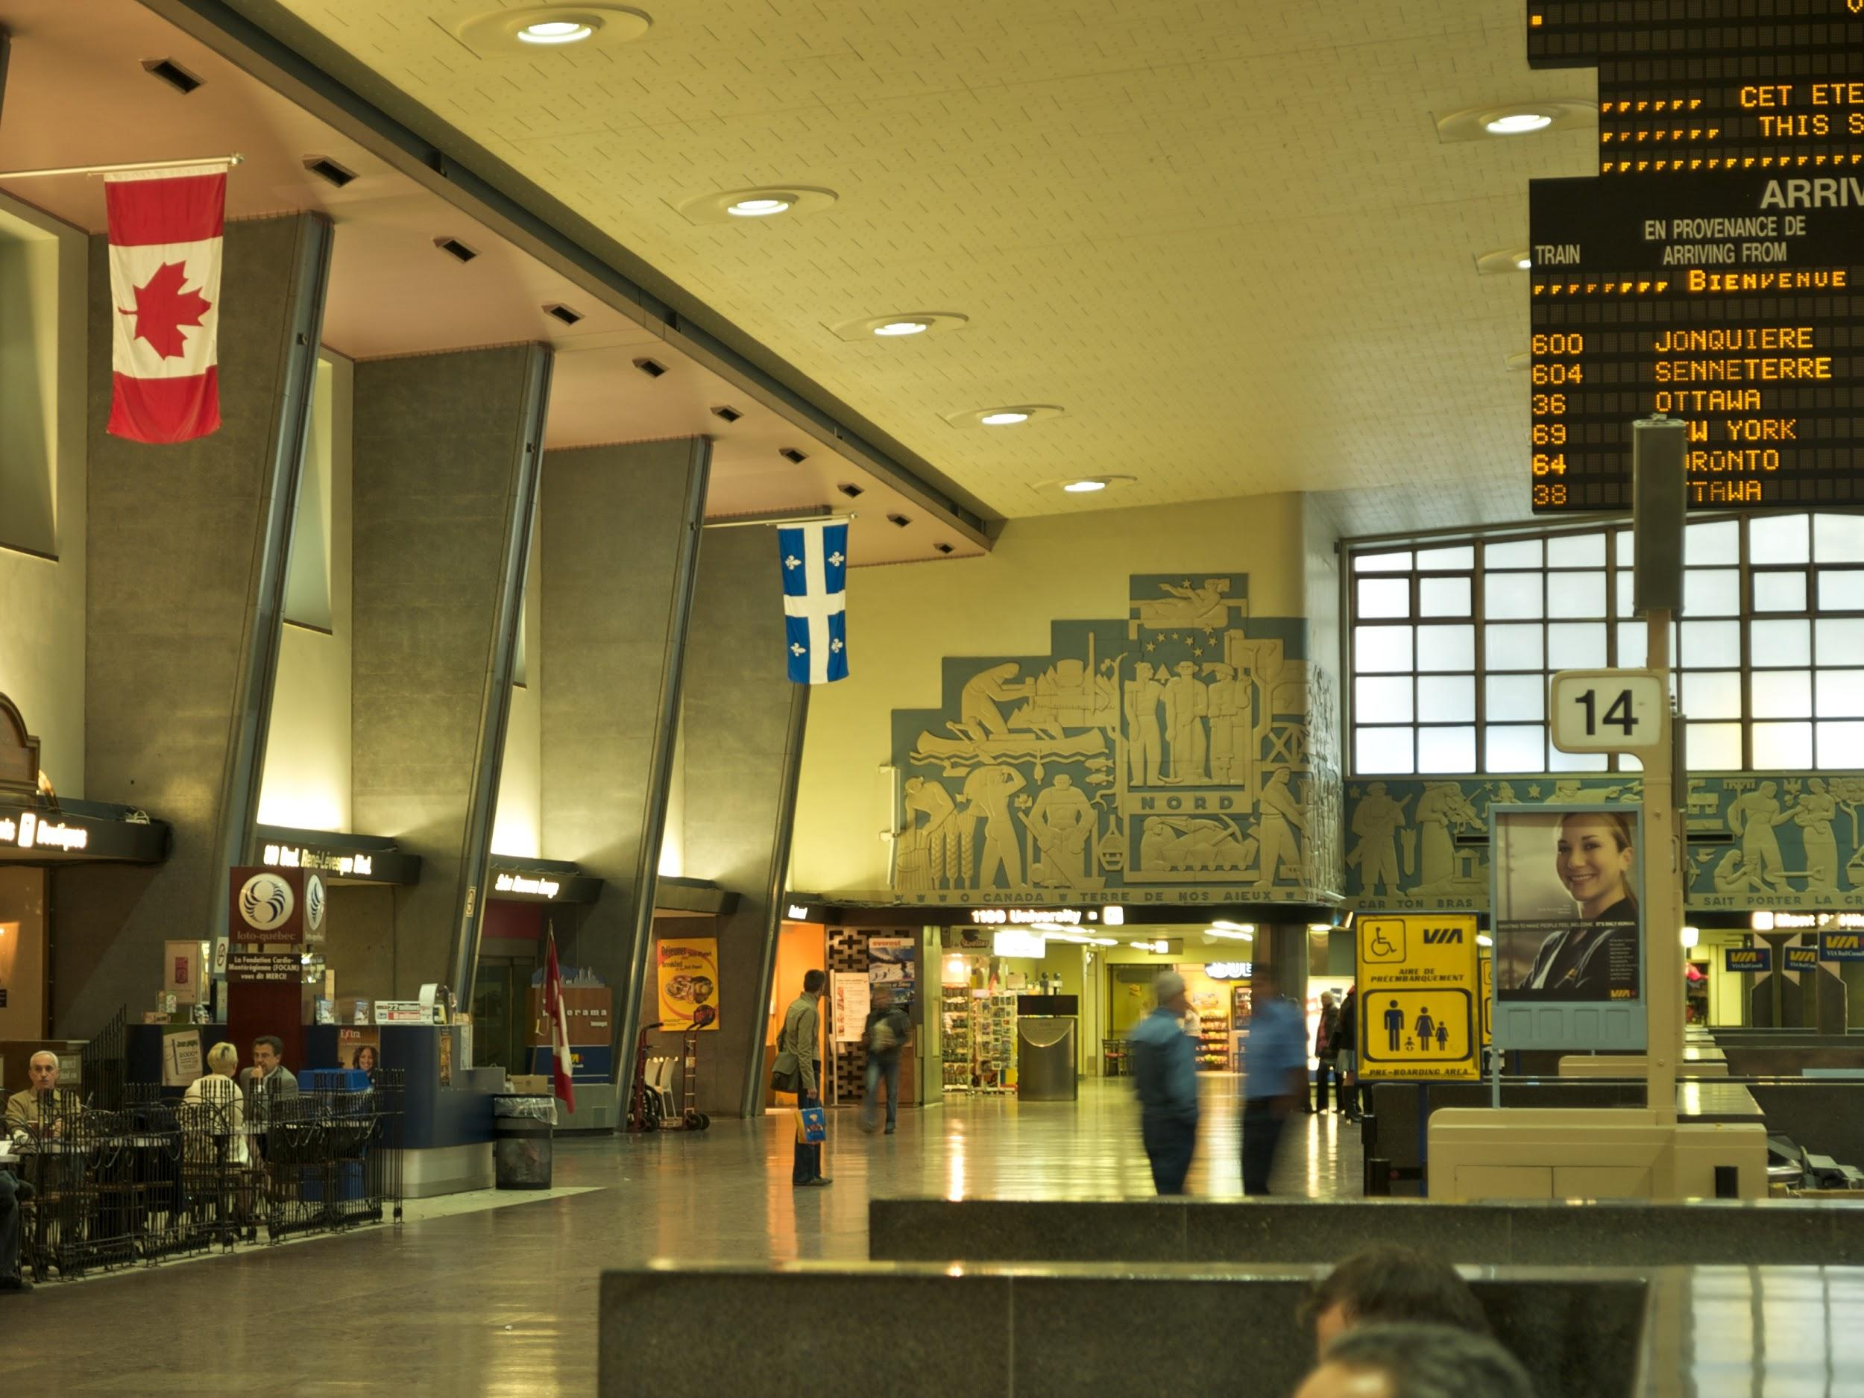
Additional Considerations
Lake Shore Limited connection in Springfield provides same day travel as far west as Buffalo
Easy connection with northbound Vermonter in Springfield
New England States would allow an easy connection to Chicago, Montreal, and Vermont from Maine, New Hampshire and western Massachusetts for the first time in decades

Slide 14
Next Steps
Stakeholder Consideration
NNEPRA ✔
Amtrak✔
Pan Am✔
Western Mass Rail Coalition✔
MBTA ✔
MassDOT
ConnDOT
CSX
Funding ($30-$50m)
Capital Improvements (1 building season after approval)
Service Startup (Immediately after Improvements)

Slide 15
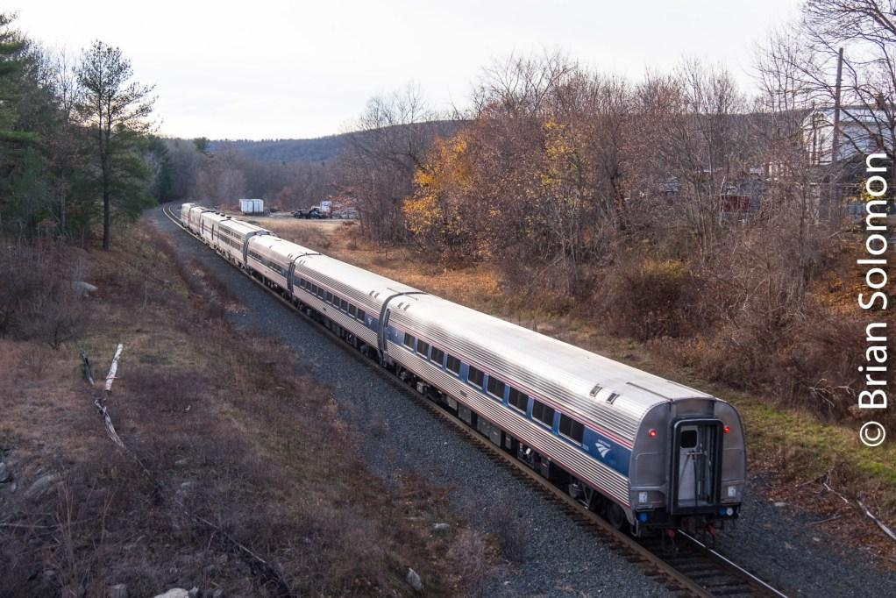
Questions

Slide 17
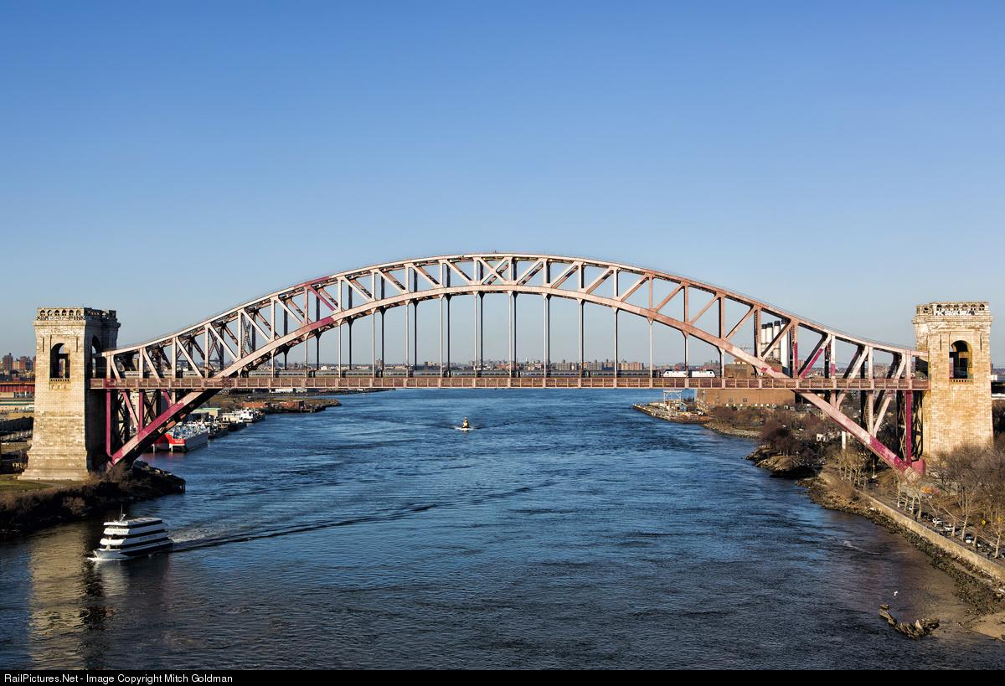
Agenda
Introduction
Background
Boston North Station/NYC Service
Additional Considerations
Next Steps
Questions

