Slide 1
Train Riders NE
Eugene Skoropowski

Slide 2
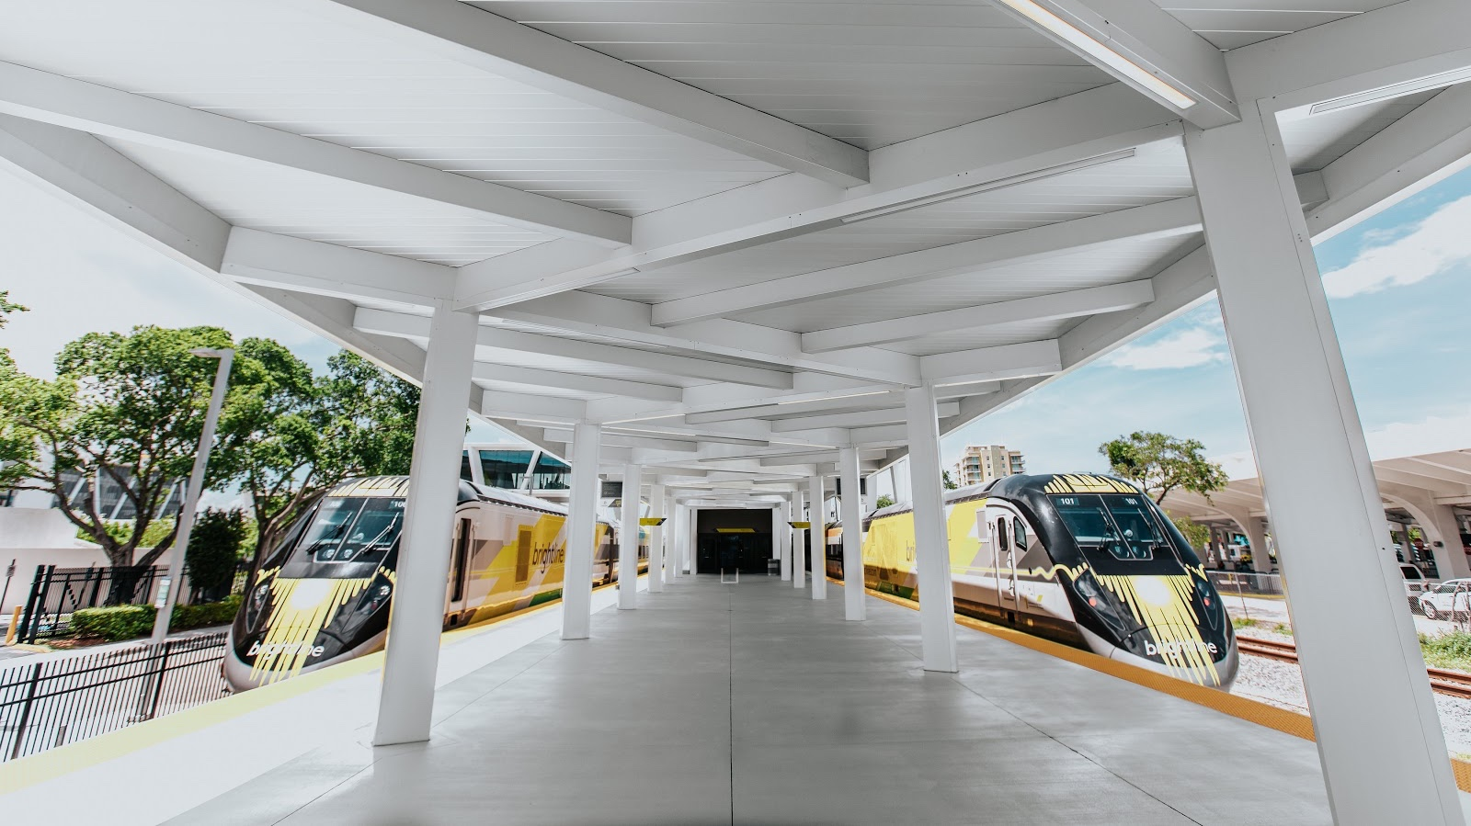
We are here to challenge
the transportation status quo and
reimagine what it means to travel
by train in America.

Slide 3
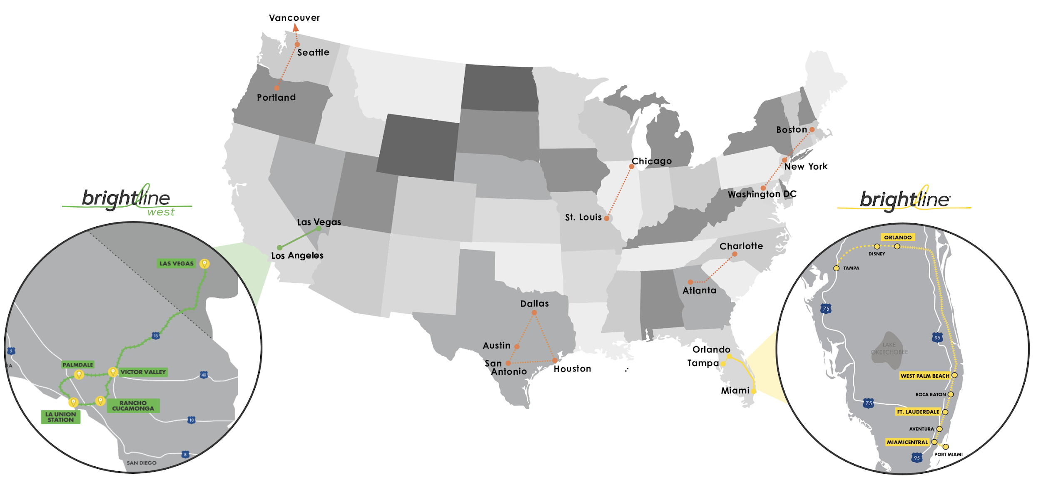

Our Company
The only major privately held express passenger rail business in the U.S.
COMPANY GOAL IS TO CONNECT CITY PAIRS THAT ARE
“TOO LONG TO DRIVE AND TOO SHORT TO FLY”
Currently operating in South Florida with an expansion to Orlando under construction.
Future planned extensions to Disney Springs and Tampa.
  Expansion project connecting Las Vegas and Southern California on track to break ground in 2021.

Slide 4
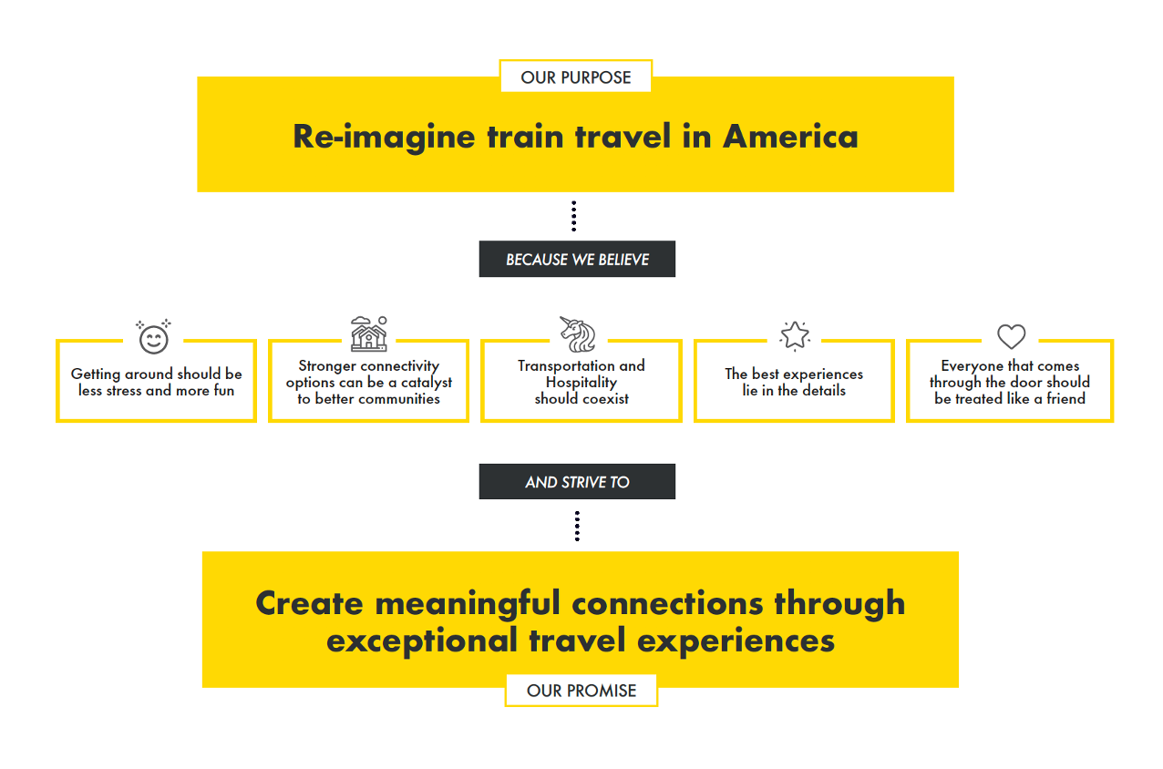
Our Purpose and Promise

Slide 5

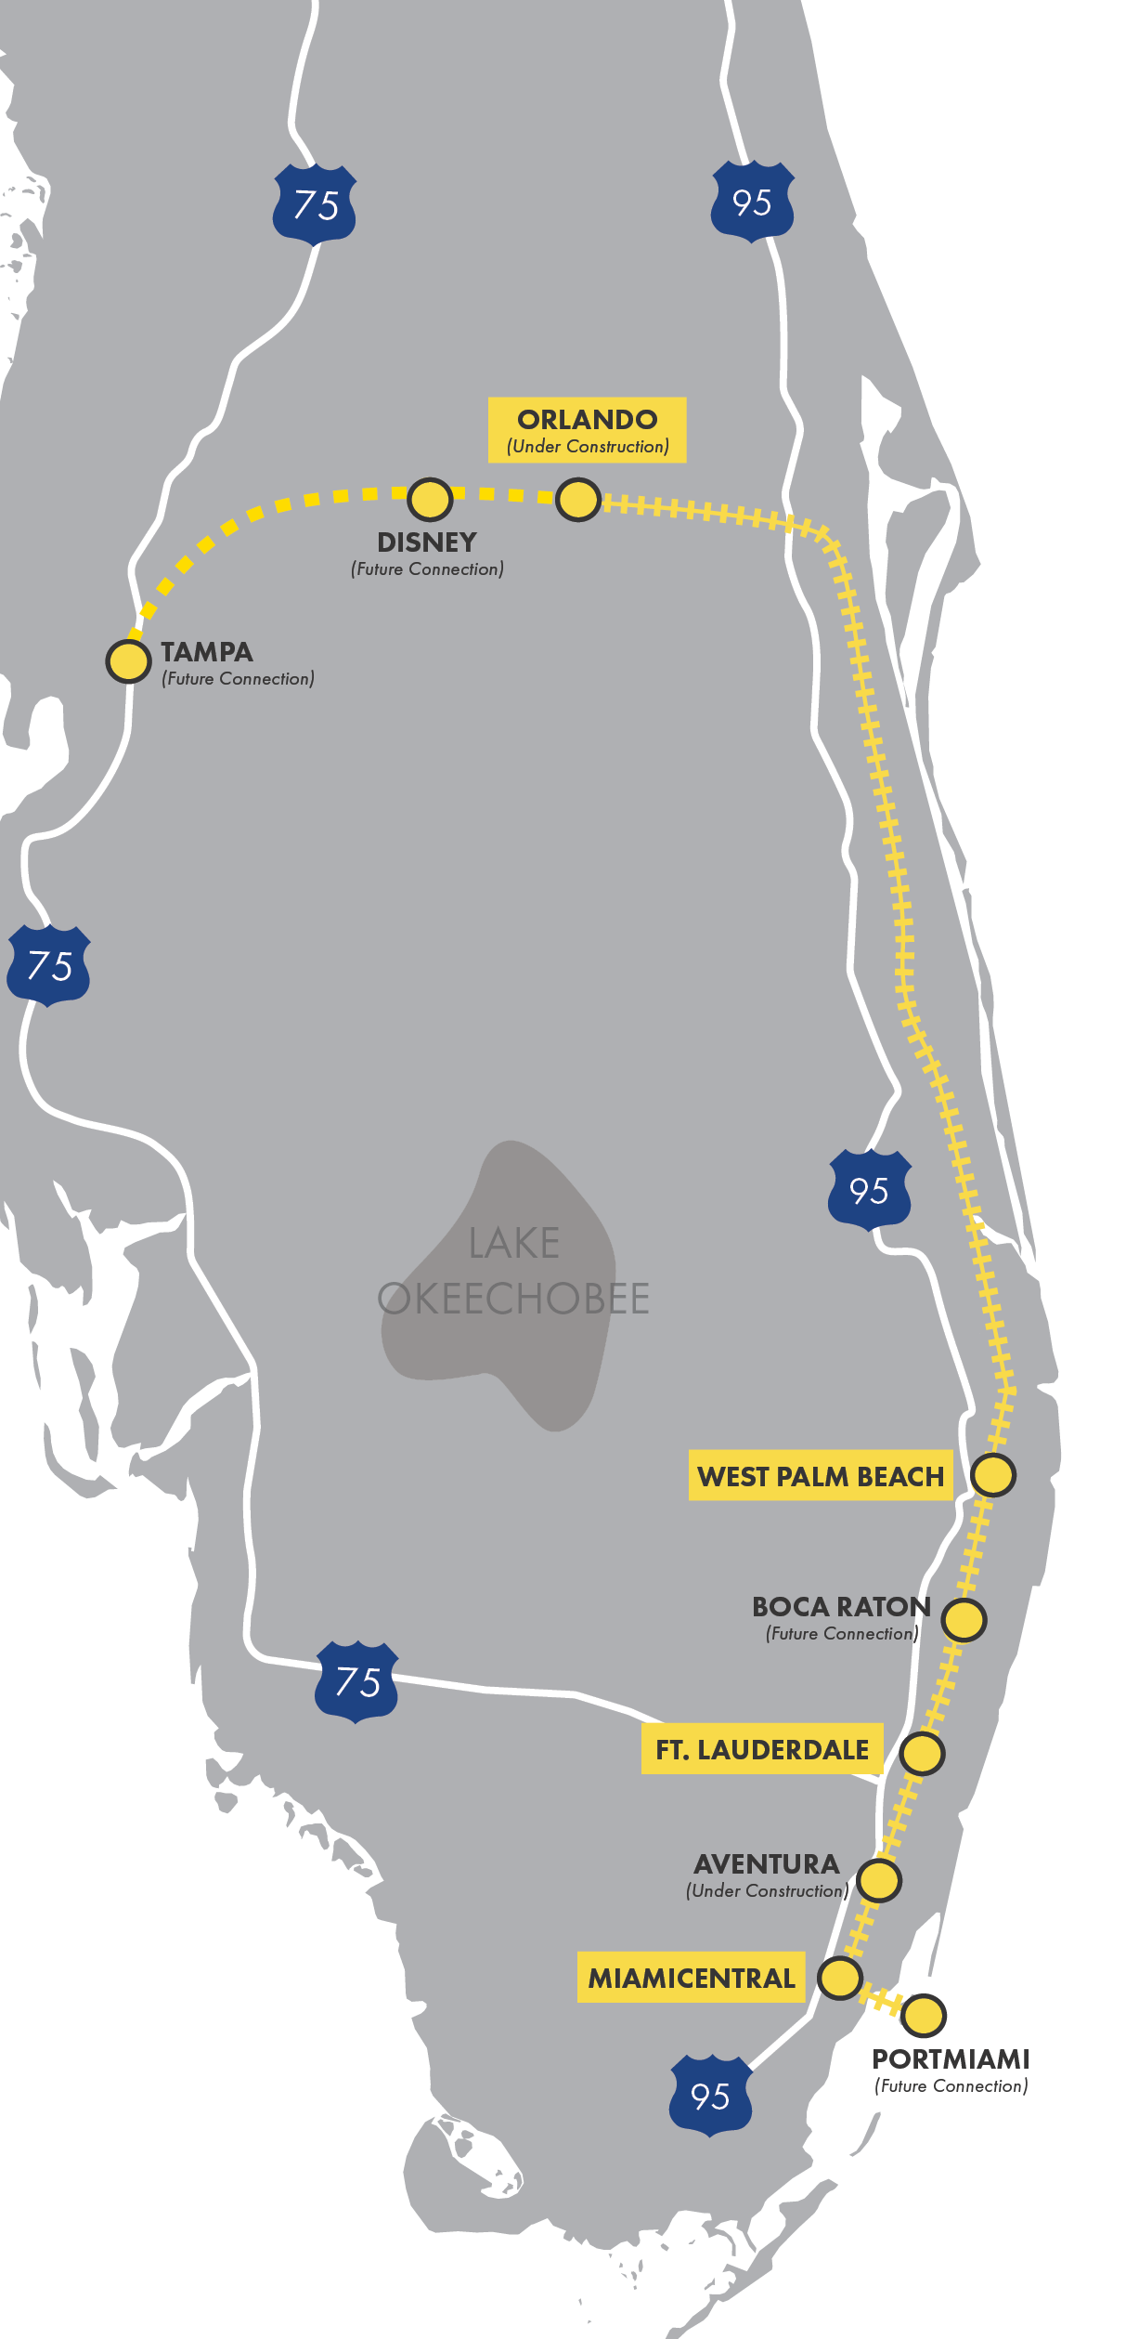
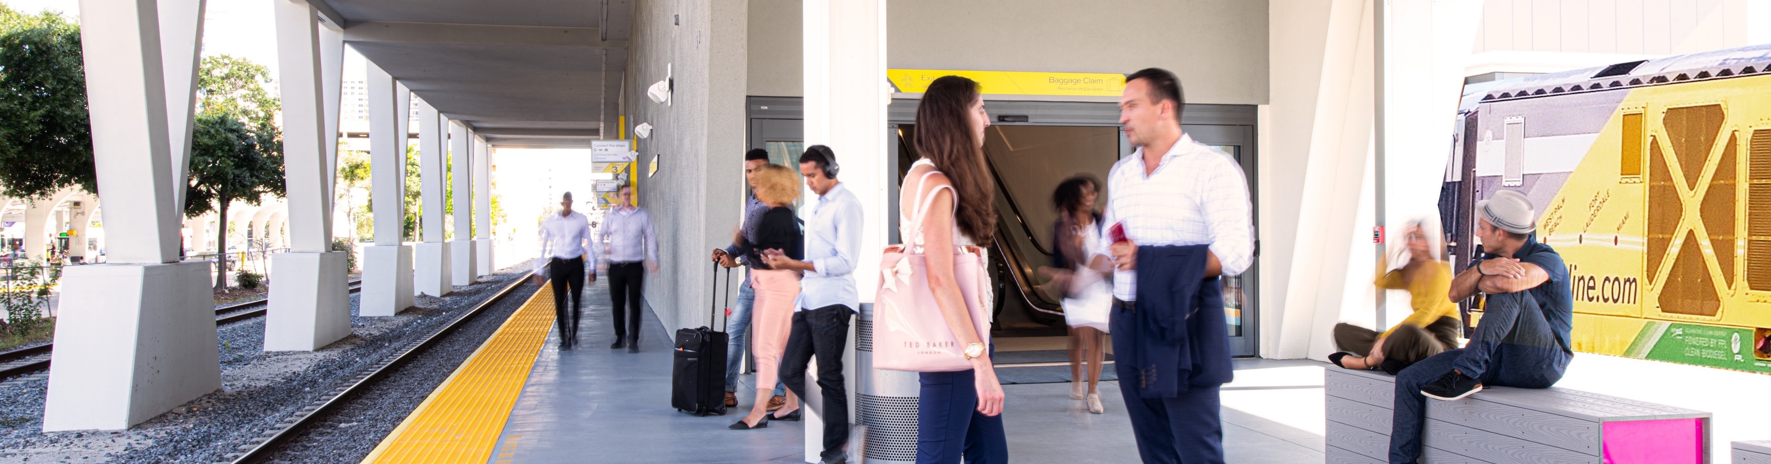
Florida System
Connecting two of the largest and most congested markets in the nation
Three completed & operational stations:
Miami Central, Fort Lauderdale and West Palm Beach
Three additional In-Line stations underway:
Aventura (2021), Boca Raton (2022)
and PortMiami (2022+)
Orlando station under construction: Orlando International Airport
Disney Spring station recently announced and
in development
Planned extension to Tampa (2029)
$2.7B
investment
45%
complete
1.6mm
man-hours worked to date
1000+
workers on the job
5

Slide 6

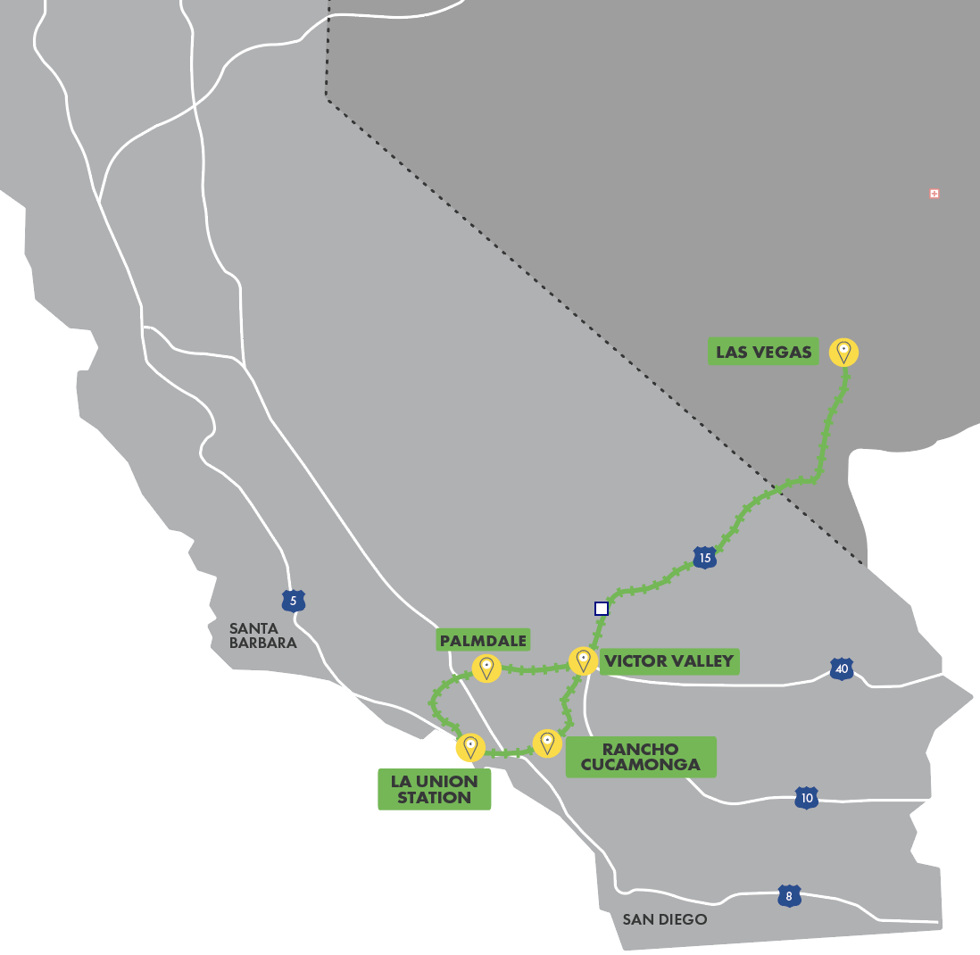
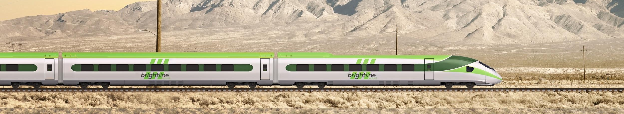
Southern California System
Southern California System
Getting to the City of Lights will get a whole lot brighter with Brightline West
Brightline West, a Brightline affiliated company, is a high-speed passenger rail system that will redefine and elevate what it means to travel by train in America. Connecting Los Angeles and Las Vegas through multiple intercity projects, Brightline West is designed to take cars off the road and offer millions of travelers a green way to travel between one of the country’s largest cities and the entertainment capital of the world.
2024
6

Slide 7
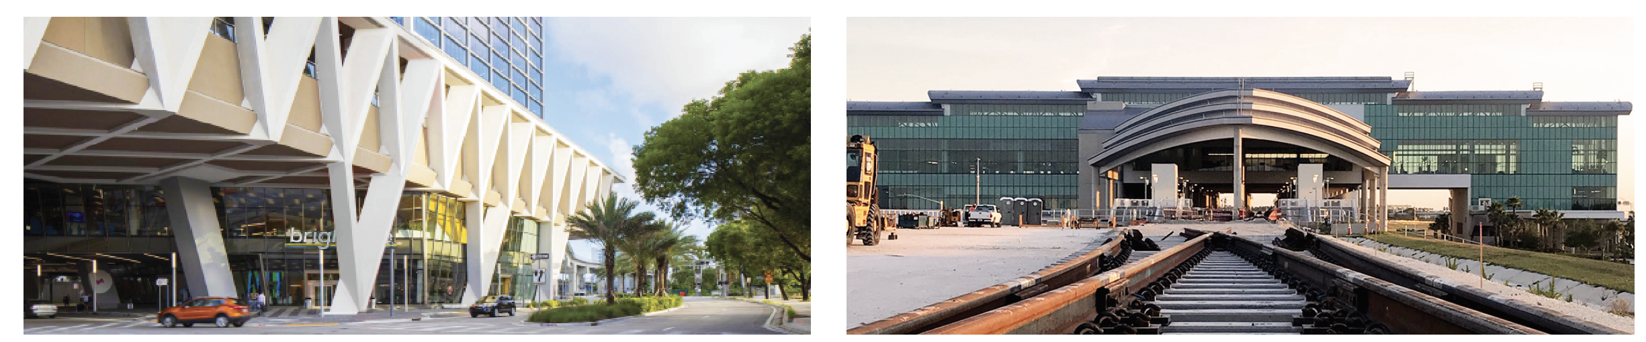
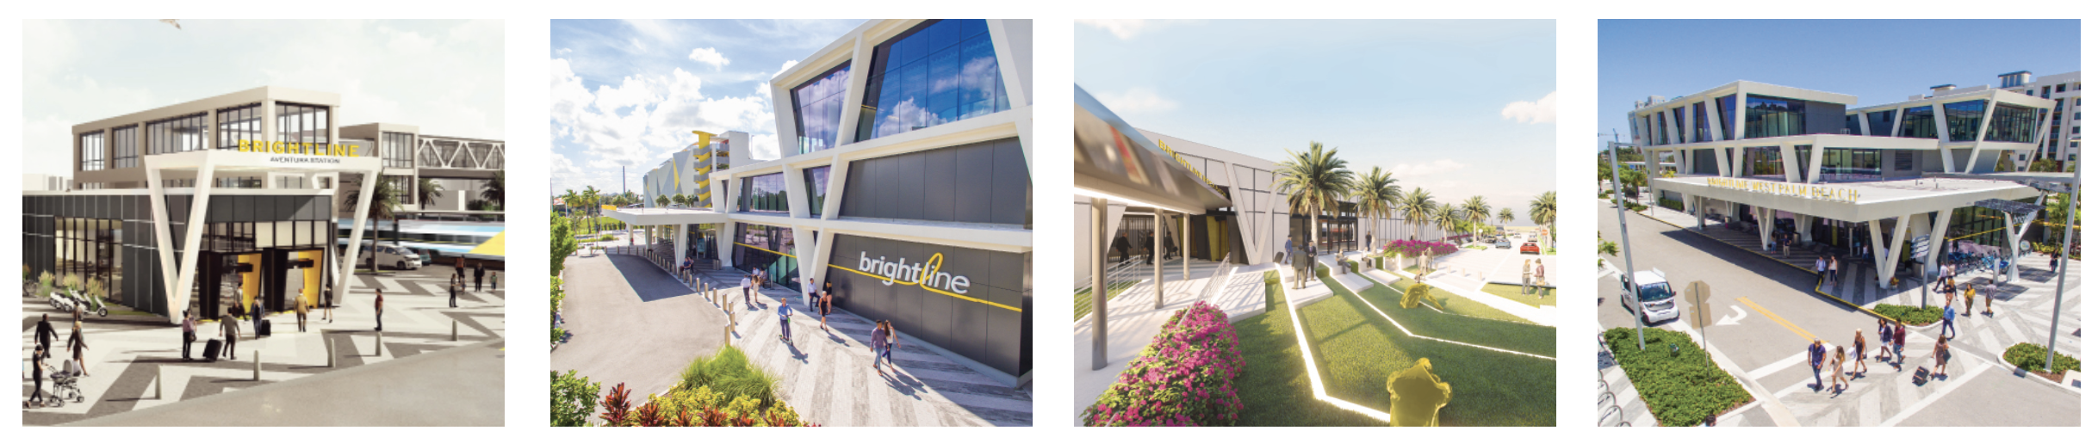
Our Stations
Centrally located in the heart of downtown Miami, and the city centers of Fort Lauderdale and West Palm Beach.
With new stations currently underway at the Orlando International Airport, Disney Springs, Aventura & Boca Raton.
FLASGHIP STATIONS
MIAMICENTRAL
ORLANDO INTERNATIONAL AIRPORT
IN-LINE STATIONS
AVENTURA
FORT LAUDERDALE
BOCA RATON
WEST PALM BEACH

Slide 8
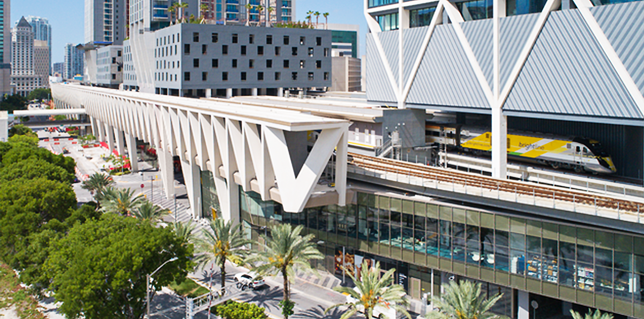
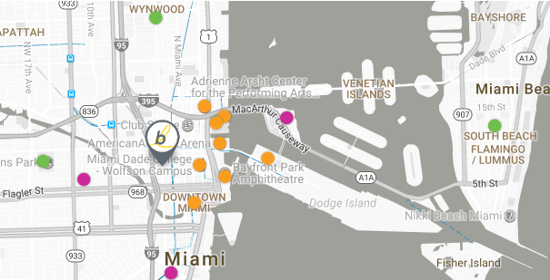




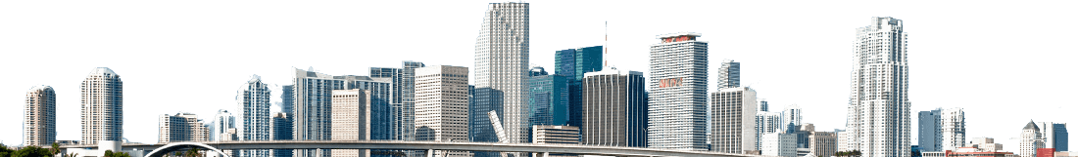
MiamiCentral
NW 1st Ave, between NW 3rd St & NW 8th St
From the immersive arts and culture to the incredible sports, events and nightlife, Miami never disappoints. Enjoy world-renowned dining and shopping, the Art Deco District of Miami Beach and relax on fabulous beaches and marinas
WALK
BIKE
RIDESHARE
PUBLIC TRANSIT
American Airlines Arena
Adrienne Arsht Center
PortMiami | Bayfront Park
Miami Dade College
Brickell | Little Havana
South Beach | Jungle Island
Coral Gables | Wynwood
Marlins Park and more
Metromover | Metrorail
Metrobus | Tri-Rail
8

Slide 9
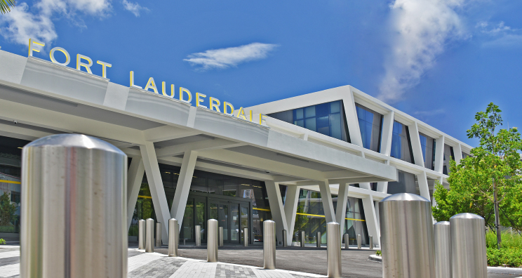
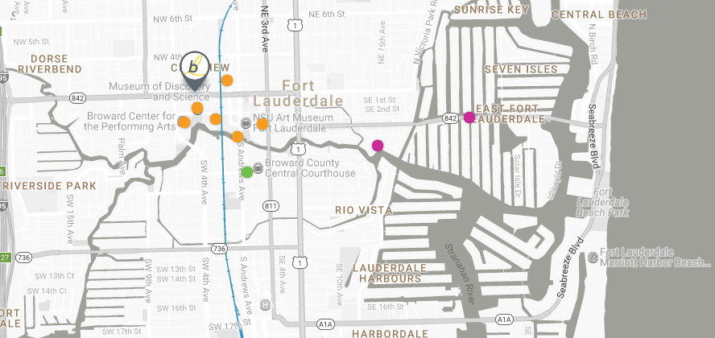
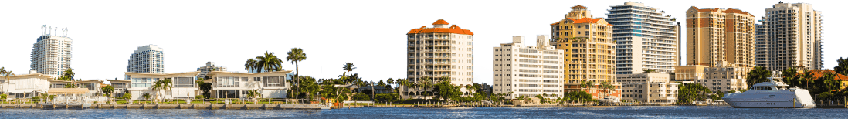
Fort Lauderdale
NW 2nd Ave, between W Broward Blvd & NW 4th St
Located in the heart of downtown, more than 100 shopping and dining options are closer than ever. A short walk and you’re at the Broward Center for the Performing Arts, museums and miles of beautiful beaches.
WALK
BIKE
RIDESHARE
PUBLIC TRANSIT
City Hall | Historic District Museum of Science Riverwalk | A&E District Broward Center for the Performing Arts | FAT Village
Las Olas Boulevard
Tarpon Bend Park
Downtown Business District
Port Everglades
Beaches | Airport
Broward Country Transit
Sun Trolley
9

Slide 10
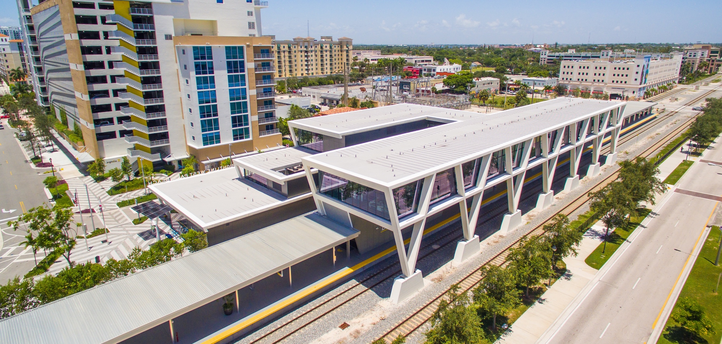
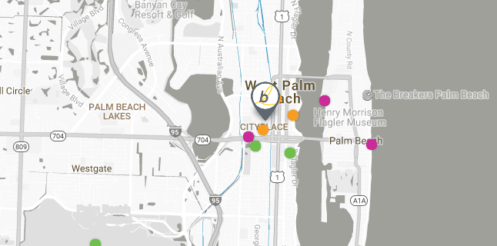
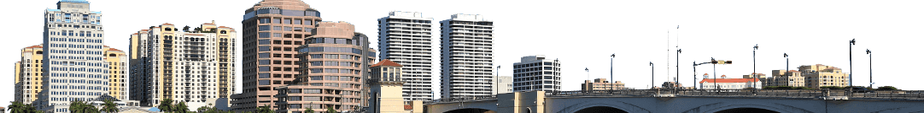
West Palm Beach
Evernia St, between S. Rosemary Ave & S. Quadrille Blvd
Located in the heart of the city, all the places you want to go to are walkable. Stroll down to West Palm Beach’s multiple art museums, entertainment venues, beaches and even wildlife sanctuaries.
WALK
BIKE
RIDESHARE
PUBLIC TRANSIT
Government Center | County Courthouse | City Hall Clematis District | Rosemary Square Centennial Park Waterfront
Flagler Museum
Kravis Center | Palm Beach Island
Palm Beach Atlantic University Convention Center
Airport | Beaches
Palm Tran
Tri-Rail
10
10

Slide 11
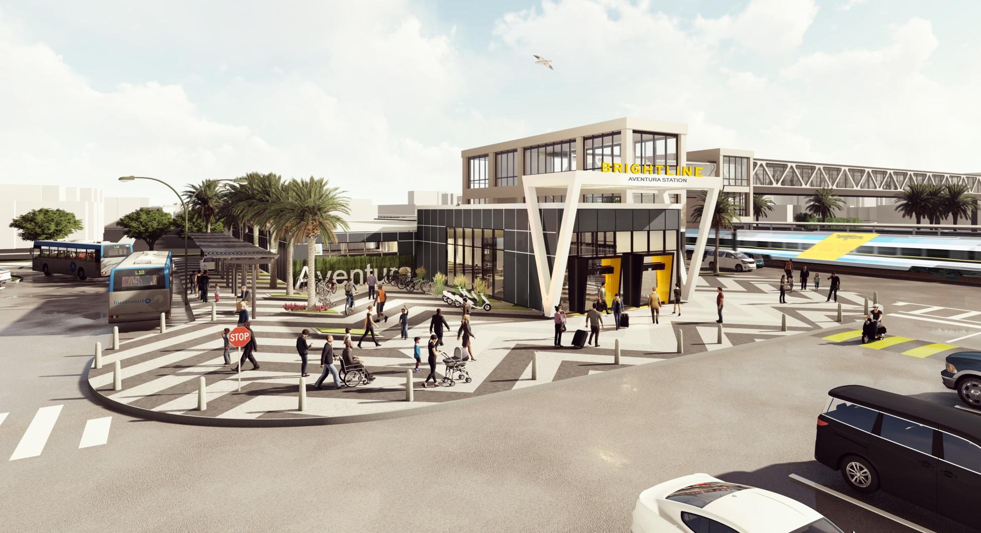
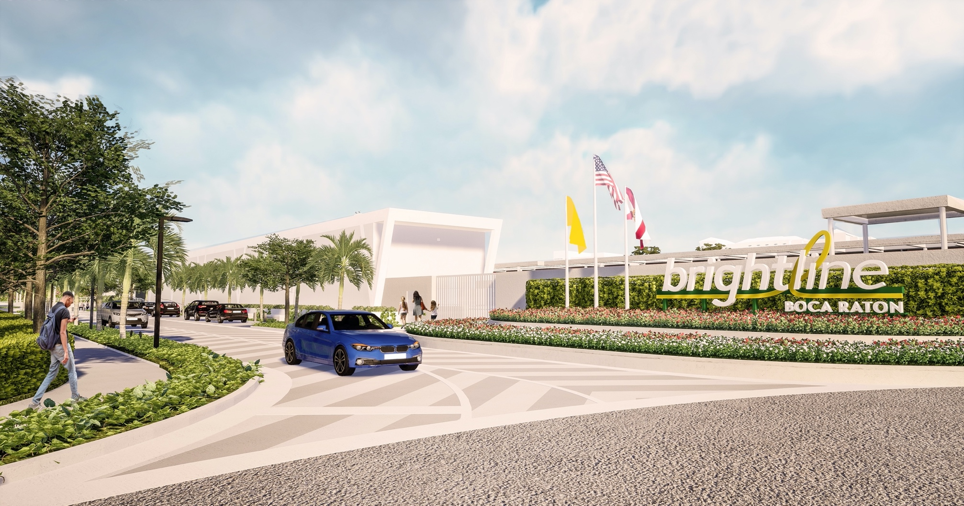
Future Stations in South Florida
Connecting you further
Aventura
Boca Raton
Received approval from Miami-Dade County in late 2019 to build station west of Biscayne Boulevard and Aventura Mall
Ground-breaking and start of construction in summer 2020
Received approval from Boca Raton City Council to build a station and parking garage December 2019
Applied for Federal Railroad Administration CRISI grant. If approved, construction will start January 2021

Slide 12
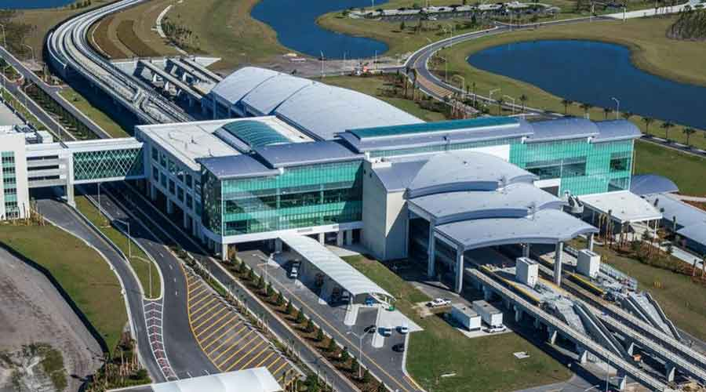
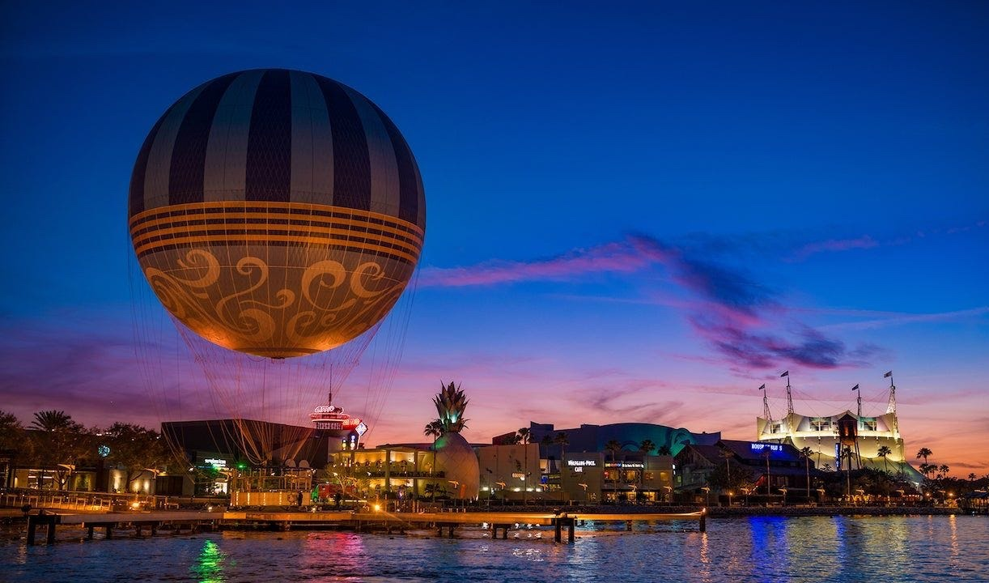
Future Stations in Central Florida
Moving the state of Florida into the future of travel
Orlando International Airport
Disney Springs
Phase 2 construction underway; expected to be completed in late 2022
Ongoing safety education, coordination and outreach
Disney station in development; working to identify station location on property
Construction to start late 2021

Slide 13
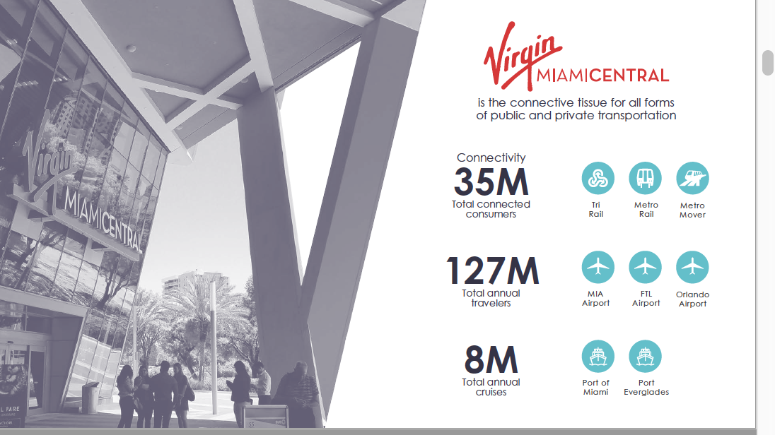
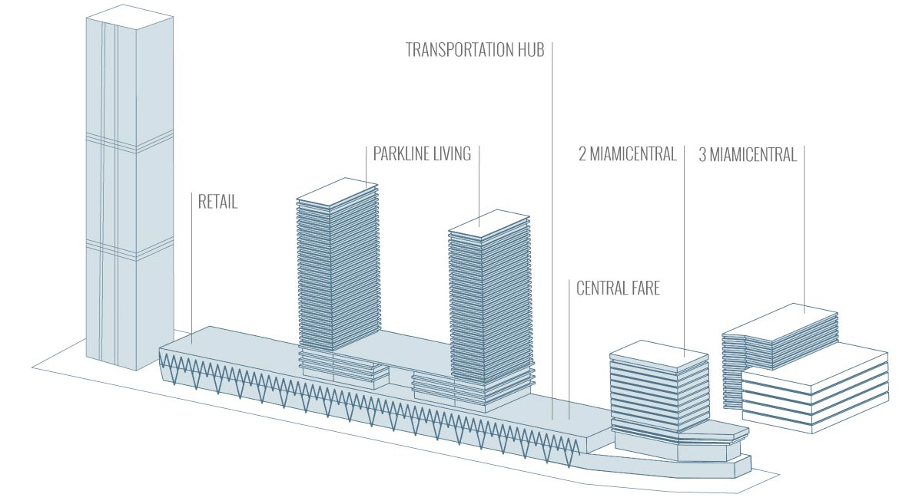
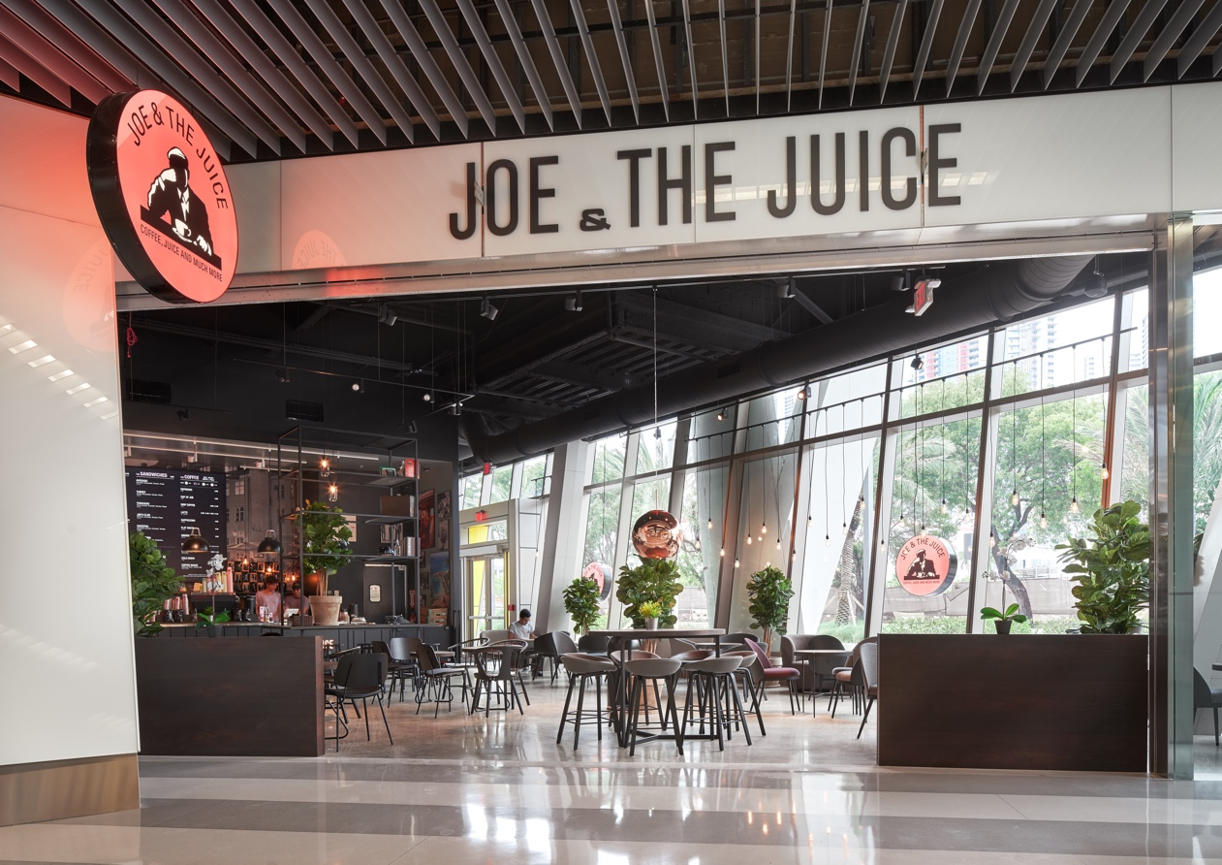
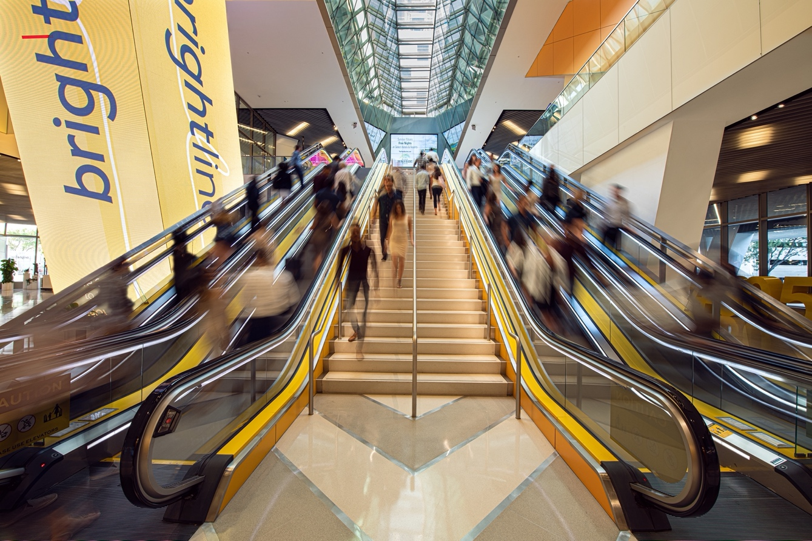
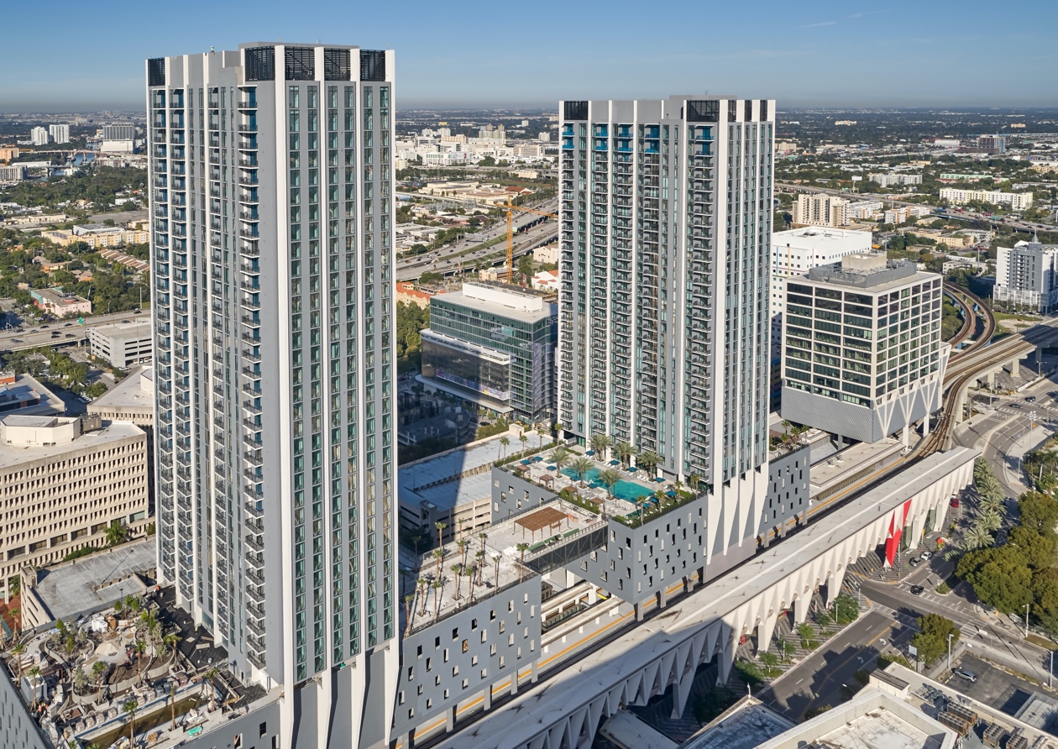
About MiamiCentral
Re-energizing Neighborhoods with Transit Hubs
A new hub for all things transportation, leisure, and business. MiamiCentral spans over six downtown city blocks delivering the true mixed-use urban experience Miami has been waiting for. Featuring Central Fare, Downtown Miami’s food hub, as well as 800+ rental residences, uniquely connected urban offices, retail space, and a major transit hub providing both local and multi-city transit options, MiamiCentral is transforming Florida’s urban landscape forever.

Slide 14
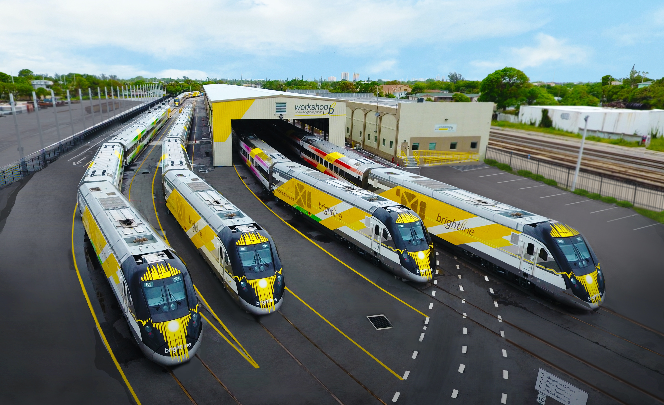

Slide 15
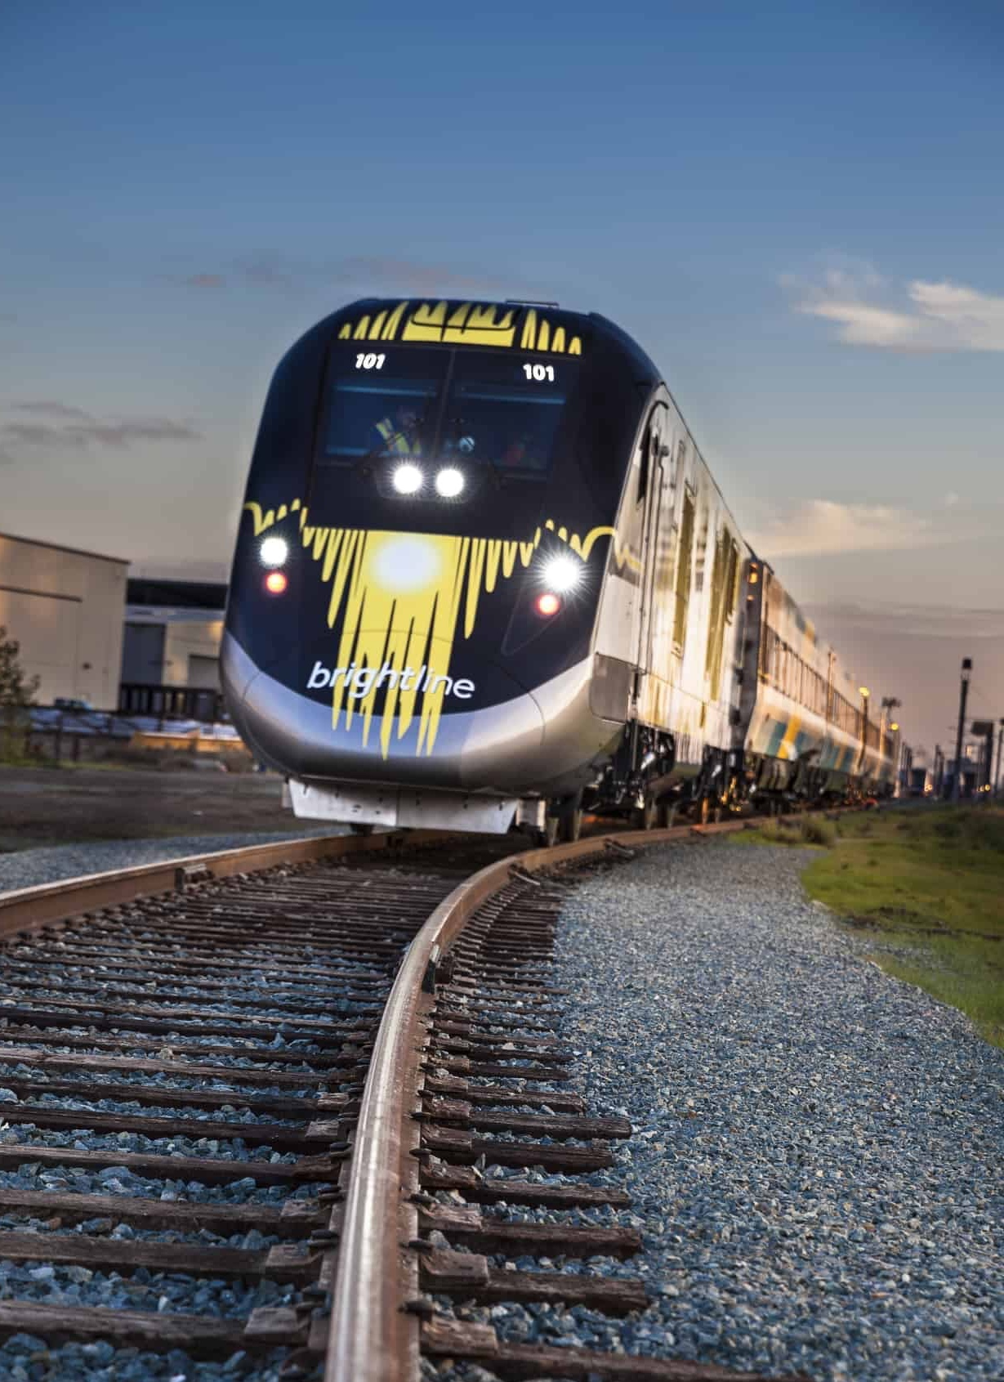

Modern American Manufacturing
Modern American Manufacturing
An all-American train that’s designed with green in mind
Custom-built in California by Siemens USA, the global powerhouse of train builders
Built with components from more than 40 suppliers in over 20 states
Most environmentally friendly diesel equipment in service
HIGHLY FUEL
EFFICIENT ENGINE
REMOVES CARS
FROM THE ROAD
20%
3 MILLION
Cars per year*
Reduction in
fuel consumption
ECO DRIVING MODE
REDUCES NOISE
CRASH ENERGY
MANAGEMENT SYSTEM
CLEAN EMISSIONS
MODULE
Safest coaches in service
Absorbs energy in the event of a collision to protect passengers
68% reduction in emissions Removes particulate matter
& Nox from our air
15

Slide 16
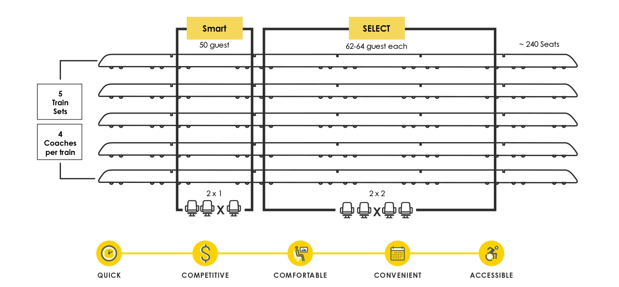
Train Layouts
Custom crafted leather seating in multiple configurations.
Reserved seating in all coaches & thoughtful functionality.
SELECT
SMART

Slide 17
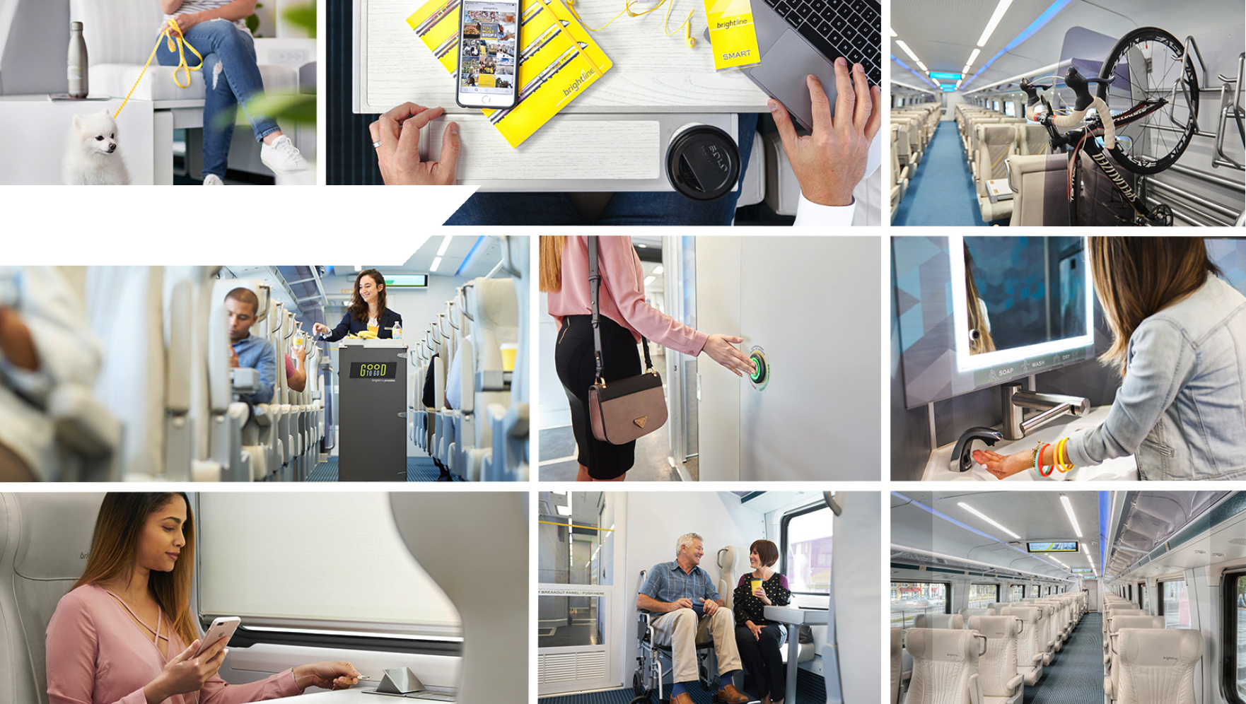
More than just a ride, it’s a one-of-a-kind guest experience

Slide 18
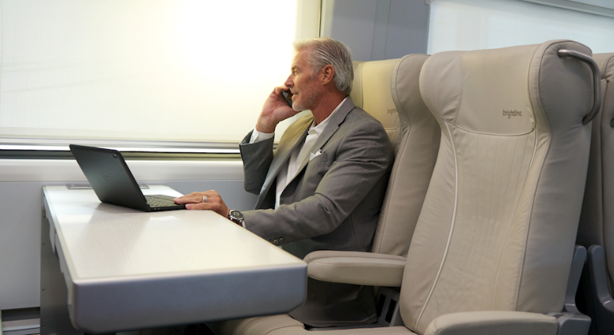













Classes of Service
Two Comfortable Coach Experiences
SELECT
SMART
Complimentary WiFi
Outlets at every seat
Luxury Seating
Additional Single Configuration
Complimentary Snacks & Beverages
Including Alcohol
Spacious Seating
Multiple Configurations
Snacks & Beverages
Available for purchase
ON BOARD
$ $
No Additional Fees
Everything’s included
Dedicated Lounge Space
High quality food & beverage
Limited Additional Fees
Reasonably priced for bags, pets, etc.
Well-appointed Guest Lounge
High quality food & beverage available
$ $ $
CHECK-IN & AT THE STATION
Preferred Access to Garage
Strategic Relationship with
Rideshare Partner
Preferred Access to Garage
Strategic Relationship with
Rideshare Partner
FIRST MILE & LAST MILE
TRAVEL OPTIONS

Slide 19
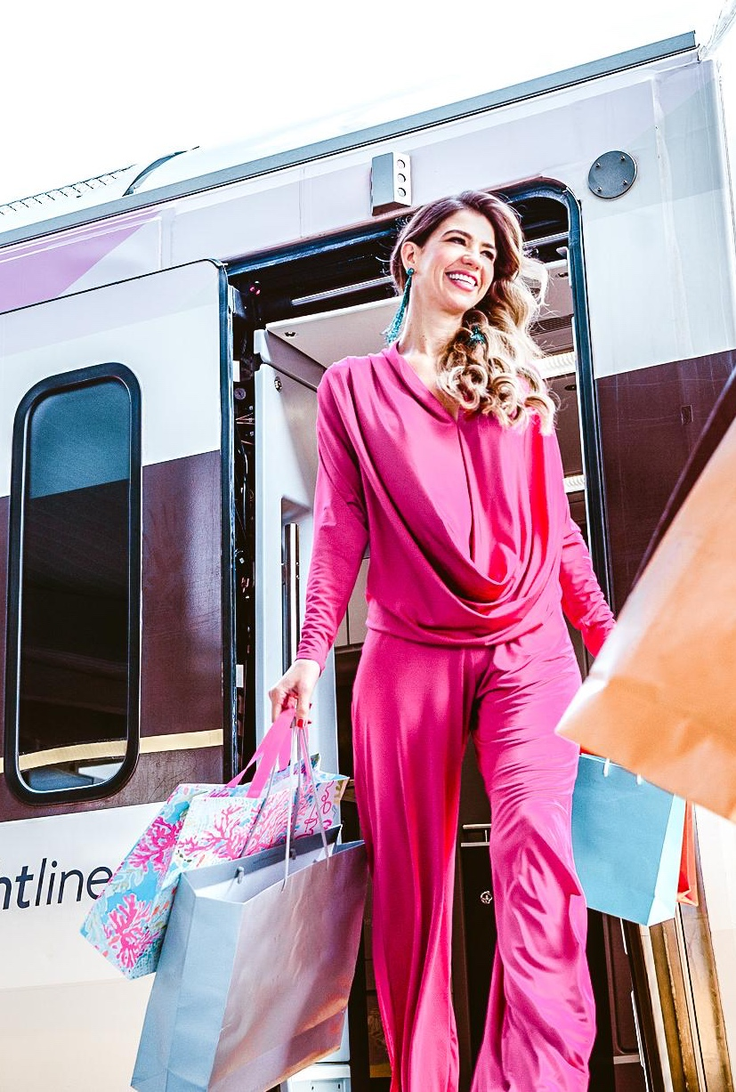







Data Insights
How it Works
The Brightline Guest
Here's what to know about our average guest
HOUSEHOLD INCOME
HOME OWNERSHIP
35% > $150k
65% > $100k
86% Own their homes
46% Own homes > $400k
GENDER
AGE
53% Male
47% Female
Average
21 - 44 years
AFFINITY AND INTERESTS
Food and Wine
Entertainment
Travel
Technology
Health
Beauty
Fashion
Luxury
19

Slide 20


Data Insights
Our Ridership Forecasts
SOUTH FLORIDA
GROWING RIDERSHIP & EYEBALLS
1.1 MM
2.3 MM
4.4 MM
Year One
Year Two
Year Three
Brightline is pacing 20% ahead of the ACELA ridership (BOS-NY-PHI-DC) at same point in company life cycle
WEST COAST
GROWING RIDERSHIP & EYEBALLS
4.4 MM
8.6 MM
10.7 MM
Year One
Year Two
Year Three

Slide 21
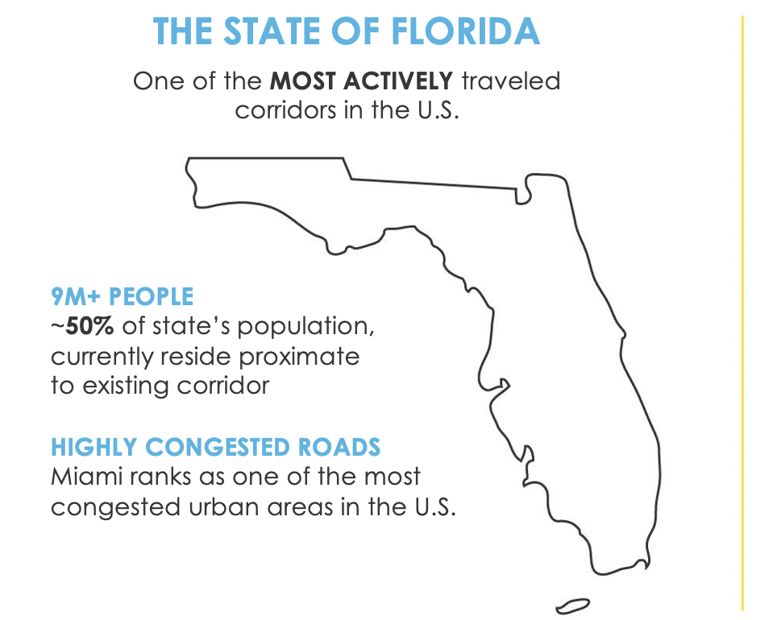
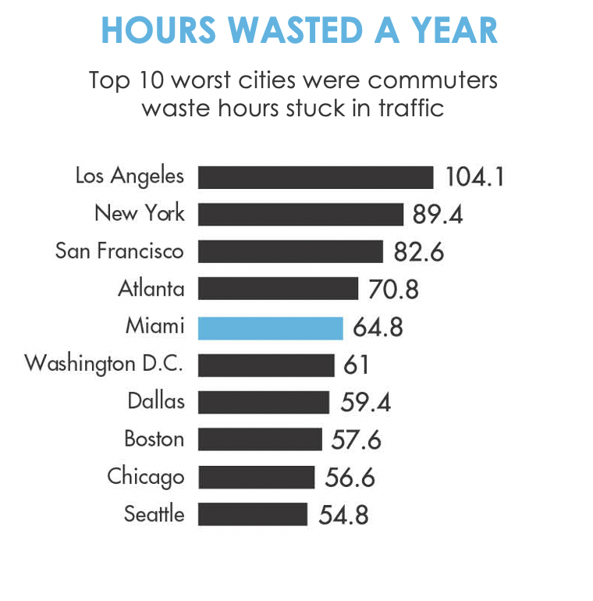

Florida’s Car Culture
An ideal market for high-speed rail
HIGHLY DANGEROUS ROADS
I-95 is considered one of the MOST DANGEROUS highways in the U.S.
More than a third of all fatal crashes on I-95 from Miami to Maine occurred in FL, over a five-year span
According to a Sun Sentinel investigation, 117 people died on I-95 in Florida in 2018 – 40% increase over 2014
Travel by car is unpredictable & unproductive. Traffic is uncontrollable.

Slide 22
Florida Impact
Investment generates profound positive impact across the state
6.4
Billion
3.5
Billion
2.4
Billion
653
Million
$
$
$
$
Direct impact to Florida’s economy over 8-year construction & implementation
Added to Florida’s GDP through 2021
In labor income through 2021
In federal, state, and local government tax revenue through 2021
10,000
+
2,000
+
3
Million
160,000
Metric Tons
Jobs created per year through rail-line construction
Jobs created post
rail-line construction
Cars removed from roadways annually
Of CO2 removed
annually
SOURCE: The Washington Economics Group was retained to provide a comprehensive, economic impact analysis study, utilizing widely accepted methodologies and specific and accurate input of data, which encompasses the construction of the rail infrastructure and Transit-Oriented Development.

Slide 23







The Benefits
Building smarter and more prosperous communities
As urban life evolves and the demand for smarter, more efficient cities becomes higher, mobility networks like Brightline play a key role in the long-term prosperity of the areas it serves. Some of the benefits the service brings to these communities include:
Boost of private capital towards infrastructure development
New & expanded
job markets
Greater connectivity
to economic centers
Increased real-estate
value through Transit Oriented Development
Less traffic on local roadways
Reduction of carbon emissions
Promotion of a
car-optional lifestyle

Slide 24
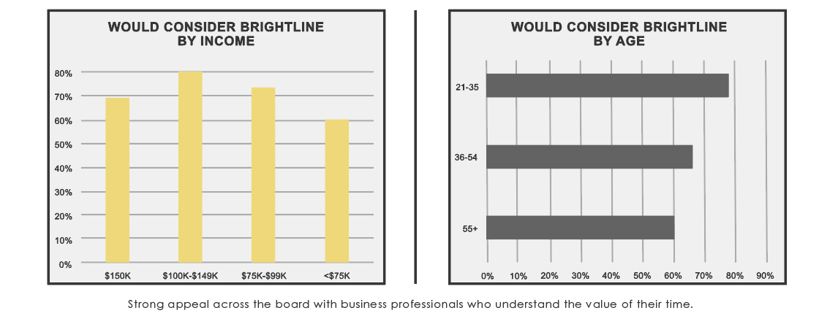
The Brightline Guest
Travel between Miami, Fort Lauderdale and West Palm Beach
WOULD CONSIDER BRIGHTLINE
By Income
WOULD CONSIDER BRIGHTLINE
By Age

Slide 25
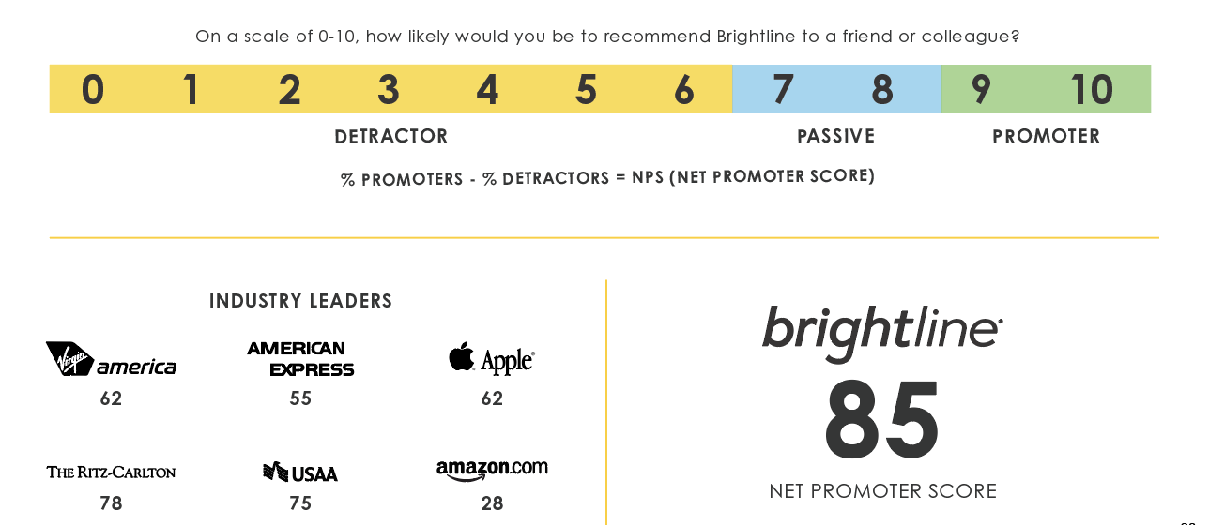
Lead Customer Satisfaction
The Net Promoter Question
75

Slide 26
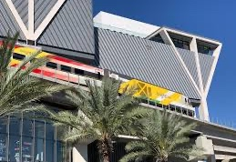
Hub to Hub
The future lies in mobility-friendly networks
ENCOURAGING CITIES TO BUILD ROBUST TRANSIT NETWORKS
One system won’t cut it
Cities need last-mile connections and viable transit systems to connect highly populated city centers
54% of riders have used a Lyft service to get to or from public transit, according to a recent study
BENEFITS OF TOD & SMART PLANNING
Improves public health
Creates a more sustainable community
Strengthens local economies
SOCIOECONOMIC & ECONOMIC IMPACTS
Demand for housing near transit is growing; studies have shown an appreciation for property values
Households that live in TODs spend on average $10,000 less on transportation each year*
TODs promote sustainability, including lower vehicle ownership and increased walking and biking
MAKING IT HAPPEN IN SOUTH FLORIDA
East-West connectors that tie into the N-S systems are key and should be studied
Multi-mobility options that provide first-and-last mile connections from stations, like Via and Lyft, are being explored by counties and cities

Slide 27
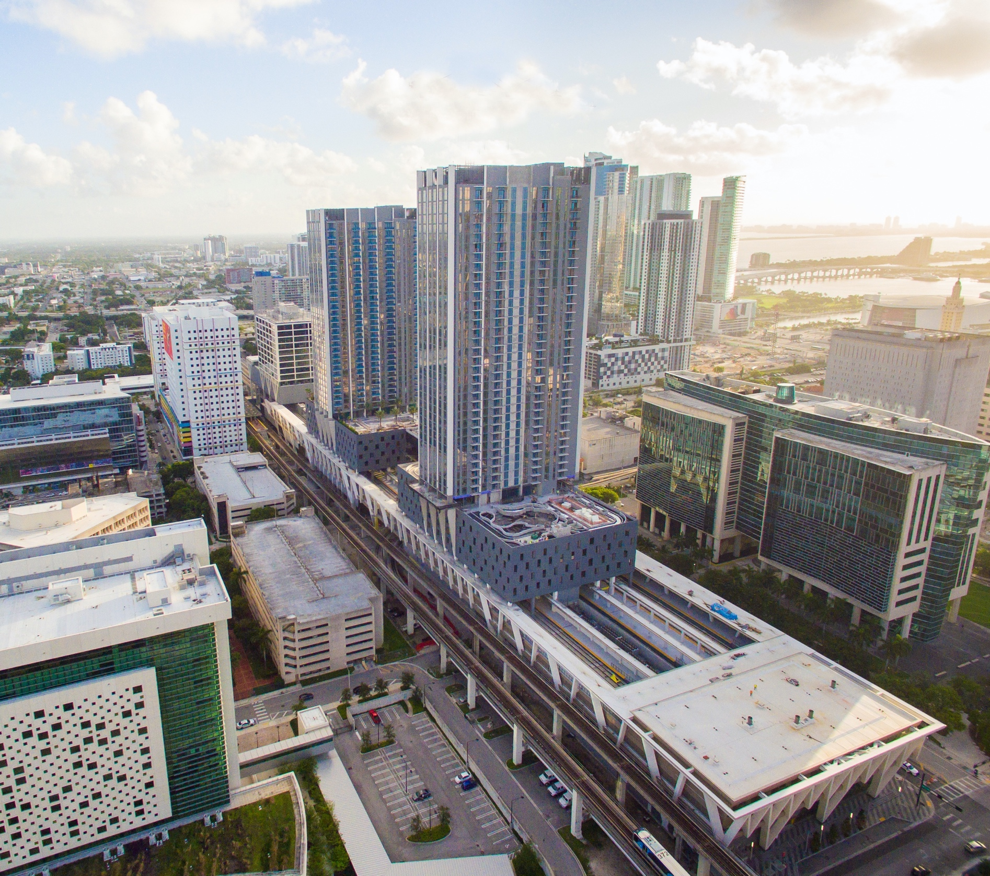





Florida Case Study
MiamiCentral: More than a transit hub, a catalyst for a new downtown
Downtown Miami is experiencing significant inflow of new construction development
Inflow of recognized tenants (HNTB, Viacom, Cisneros, Ernst & Young and Concacaf)
Brightline station serves a critical transportation need in a rapidly developing area
DEVELOPMENT (IN AND AROUND MIAMICENTRAL)
RECENTLY COMPLETED
UNDER CONSTRUCTION & PLANNED
1,500 Condo Units &
2,700 Apartment Units
3,000 Condo Units &
5,000 Apartment Units
140,000 SF of retail space
850,000 SF of retail space
328 Hotel Units
4,000 Hotel Units
A BIGGER DOWNTOWN COMMUNITY AS A RESULT
+150k daytime population
+50k new residents

Slide 28

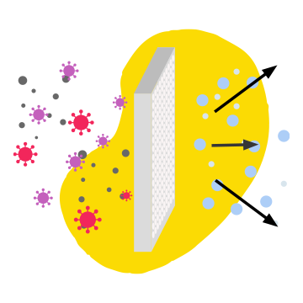
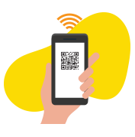


Post-COVID-19 World
Transportation trends post-COVID
Brightline is pioneering new standards for clean and healthy travel
In South Florida, traffic and movement have continued to increase and rebound as people go back to work
Full suite of protocols to ensure traveler safety
EXISTING SAFETY MEASURES
ADDITIONAL MEASURES WE HAVE TAKEN
Train Air Filtration
Consistent stream of fresh air introduced to train air system
UV light filters installed in all A/C units
Heightened Prevention
Application of Aegis Microbe Shield to high touch areas on trains that inhibit the growth of bacteria for up to one year
Touchless Technology in Traditionally High-Touch Areas
Motion sensor lighting, faucets, toilets, doors
and hand driers
Low to No-Touch Accessibility
Cash free trains and stations
E-Ticketing for mobile ticket scanning
Electronic menus on-board
Frequent, Enhanced Cleaning
All surfaces are regularly cleaned
Trains are cleaned before every departure
Disinfectant solution dispersed through station
air filtration system

Slide 29
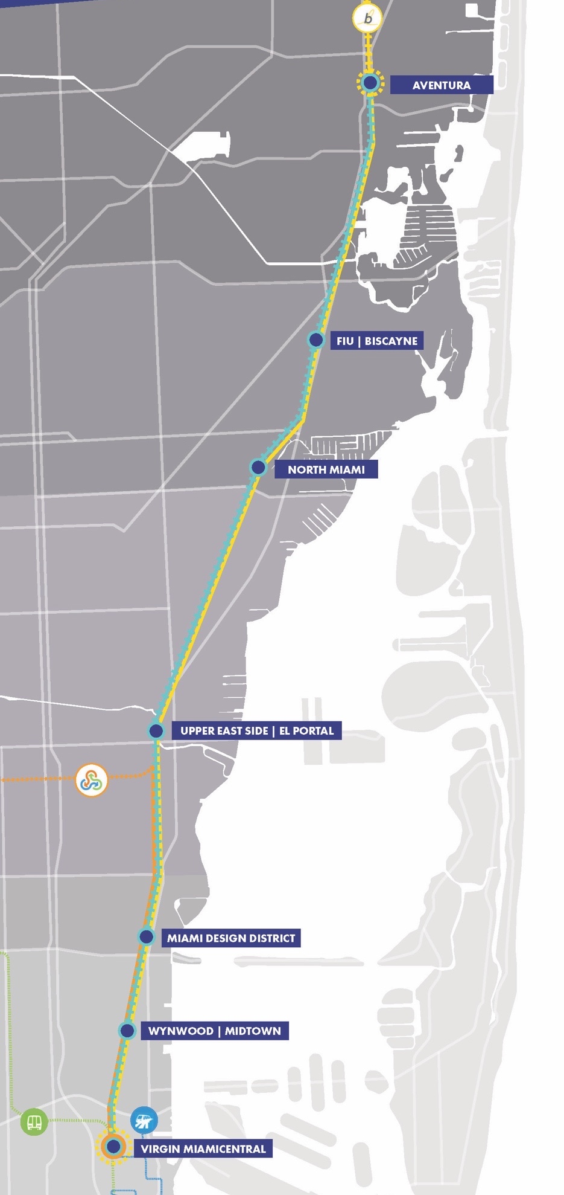
Connections Matter: Commuter Rail
Working together for a better-connected Florida
NE Corridor commuter rail initiative has been studied and supported for decades
In November, Miami-Dade County Commission approved an access fee and is finalizing planning for a commuter rail system
Commuter rail will be complementary to Brightline service
NE Corridor to be fully integrated with Metrorail, Metromover, Tri-Rail and Brightline
Ultimate goal is to expand system to Broward and Palm Beach counties
…but we need more last-mile connections
29
29

Slide 30
THANK YOU

