Slide 1
The (Near-Term) Future
of U.S. Intercity Passenger Rail
Ross Capon -- Independent Consultant
President Emeritus, Rail Passengers Association
Washington Representative, American Association of Private Railroad Car Owners
Presentation to TrainRiders Northeast’s
Annual Meeting -- March 25, 2021

Slide 2
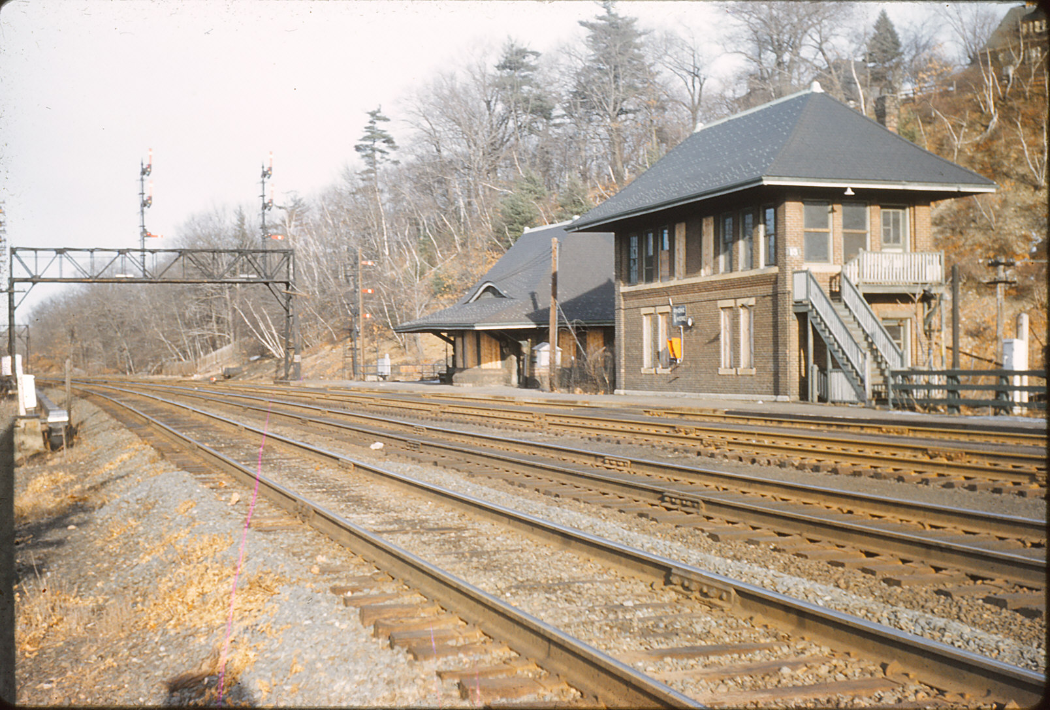

Slide 3
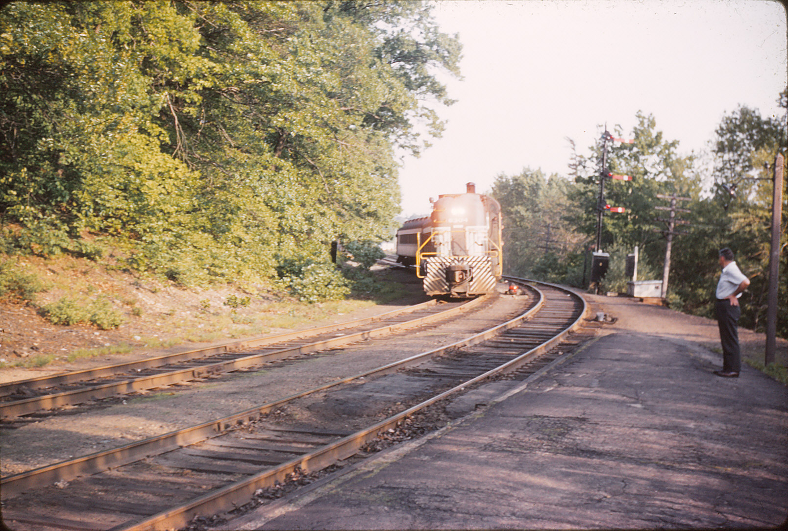

Slide 4
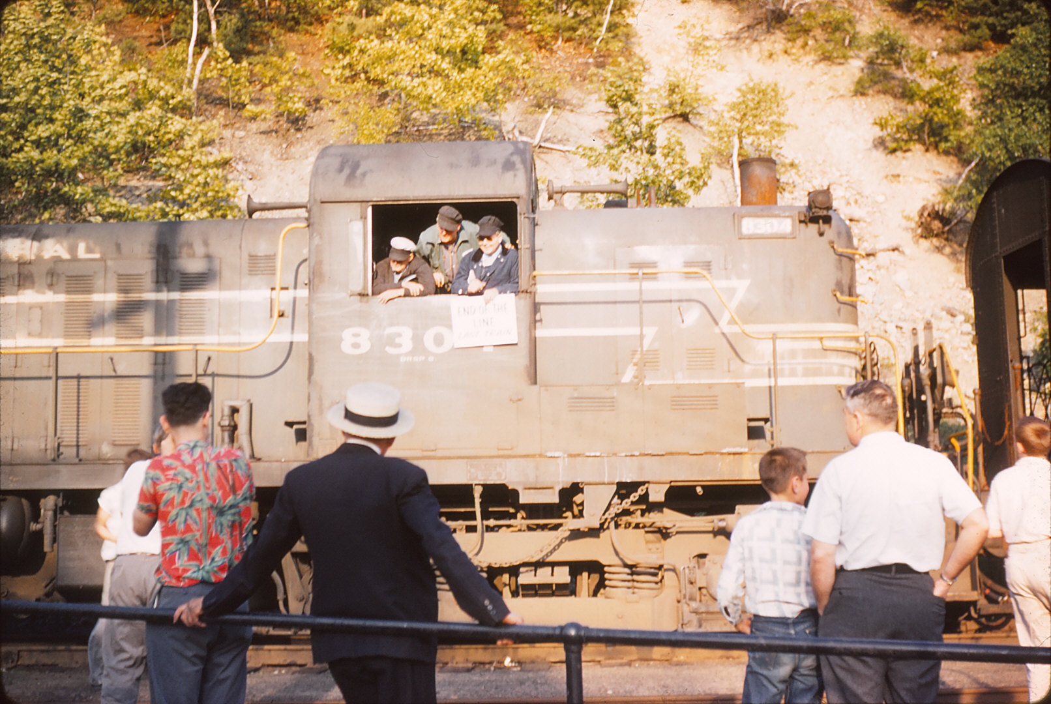

Slide 5
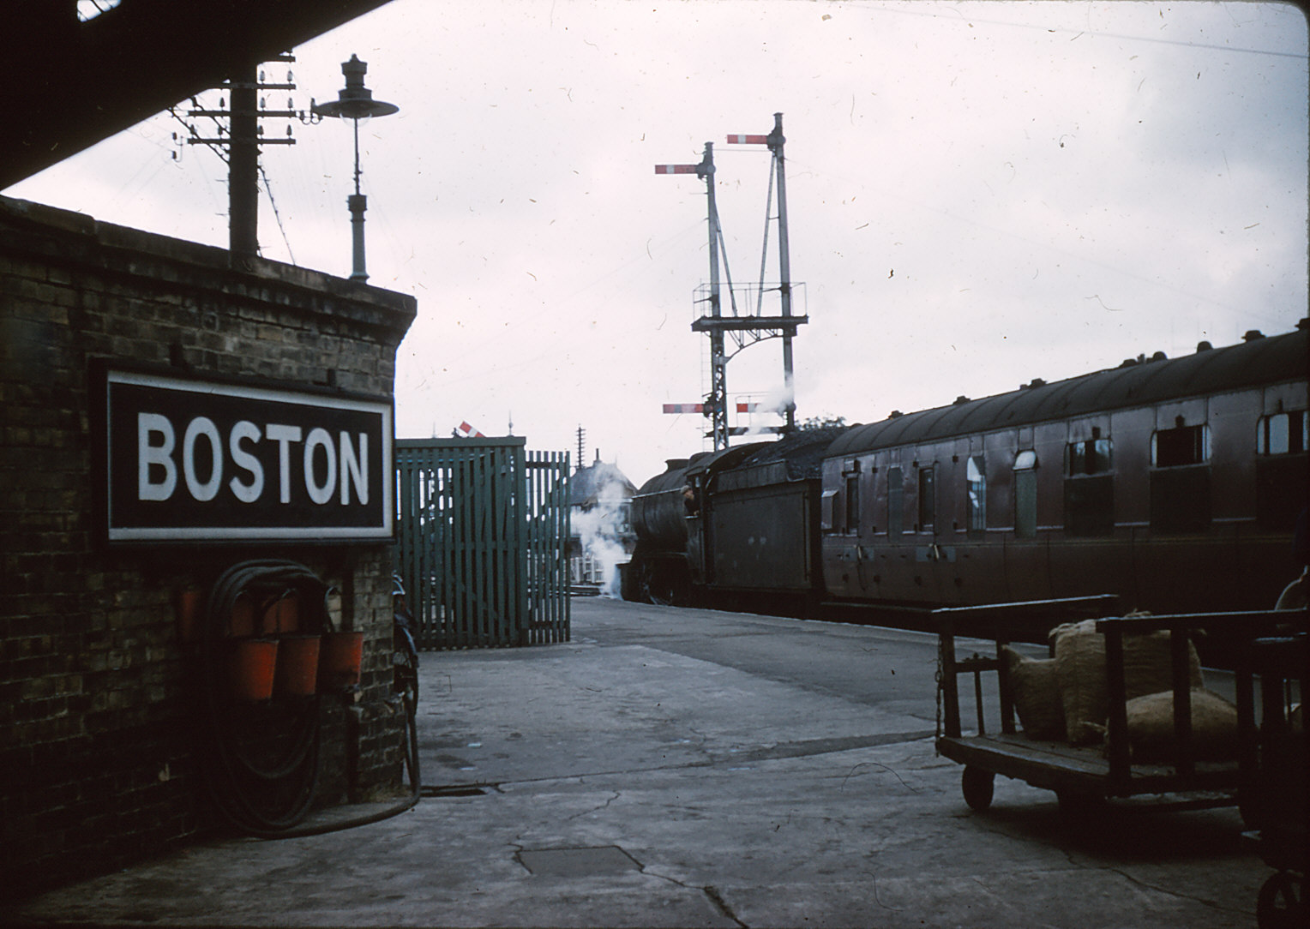

Slide 6
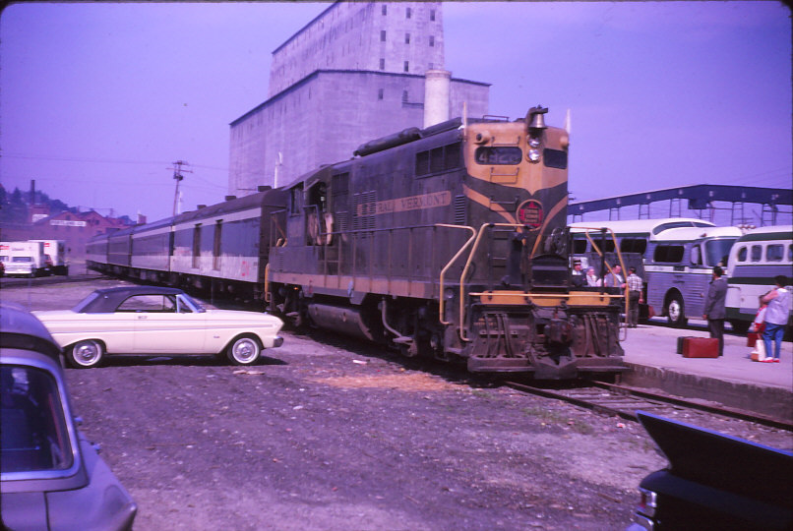


Slide 7
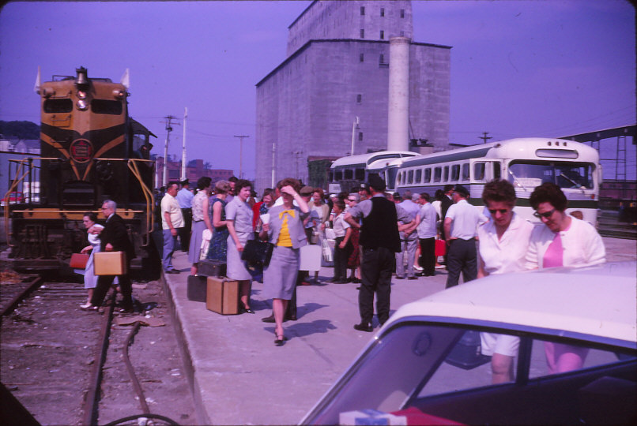

Slide 8
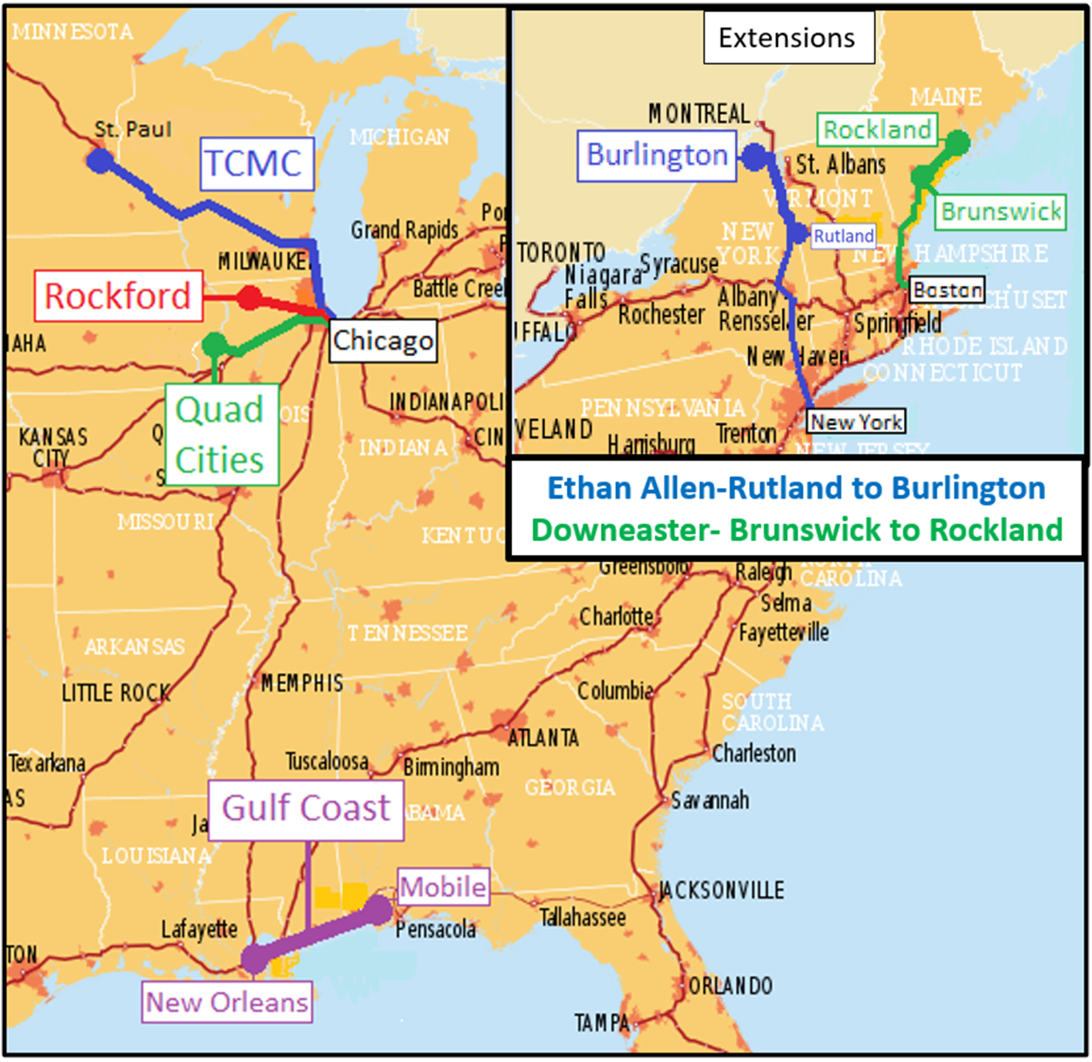

Slide 9
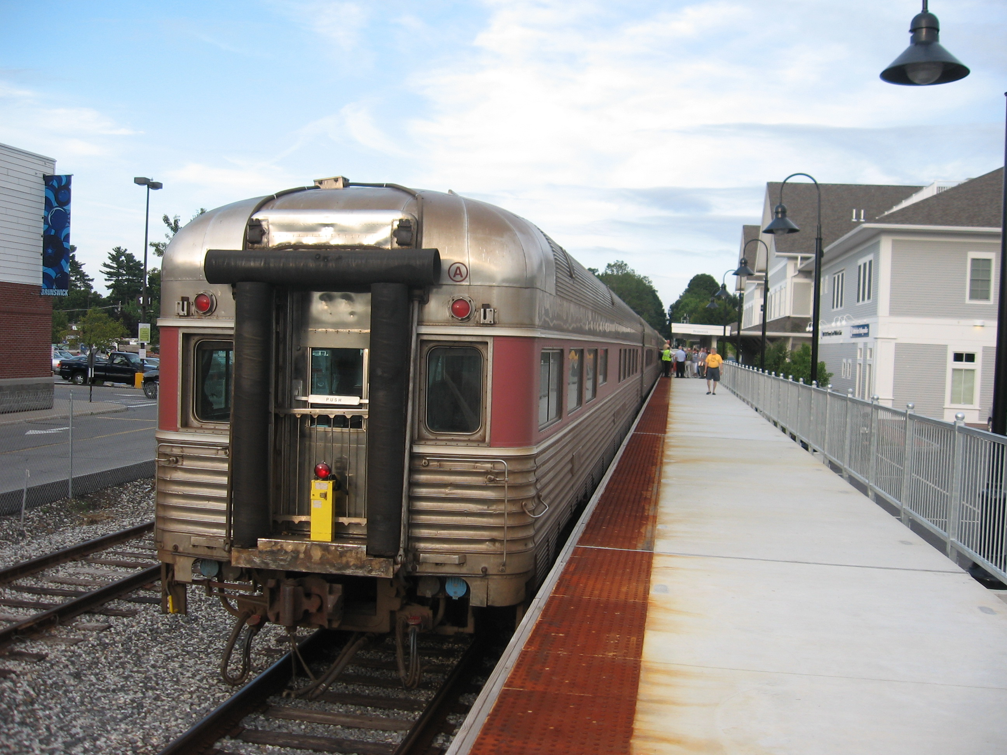

Slide 10
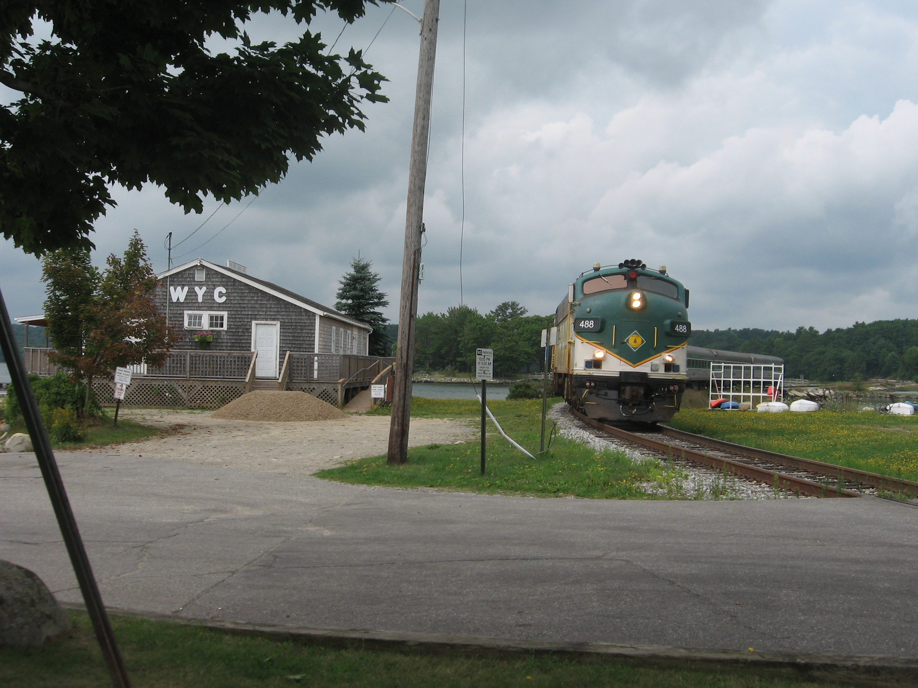

Slide 11
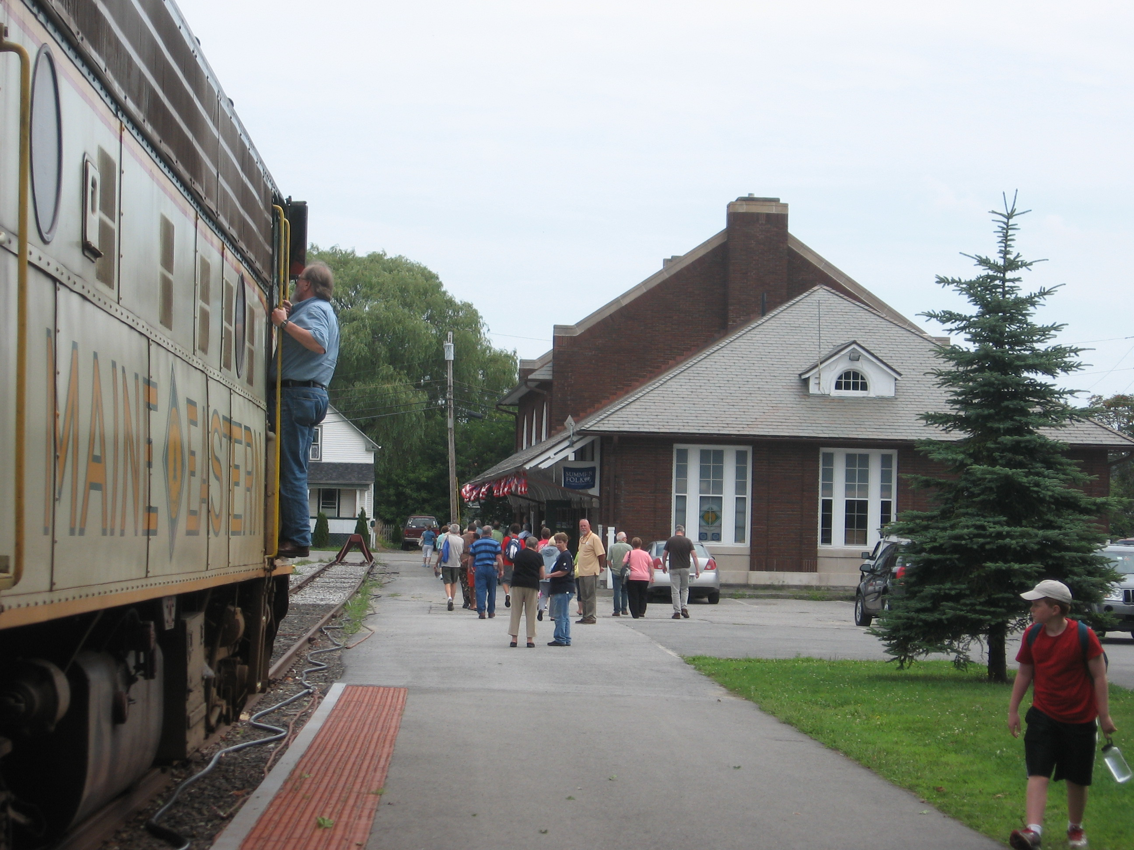

Slide 12
The Return of Daily Service
May 24: California Zephyr; Coast Starlight; Empire Builder; Texas Eagle
May 31: Capitol Limited; City of New Orleans; Lake Shore Limited; Southwest Chief
June 7: Crescent; Palmetto; Silver Star; Silver Meteor

Slide 13
New in the 117th Congress—Senate
Gary Peters (D-MI) chairs Senate Commerce Subcommittee on Surface Transportation, Maritime, Freight and Ports – succeeds Tammy Duckworth (D-IL), who was ranking member on this subcommittee but now chairs the Armed Services Airland Subcommittee
Brian Schatz (D-HI) chairs Senate Appropriations T-HUD subcommittee – Jack Reed (D-RI), previously ranking on this subcommittee, now chairs Armed Services

Slide 14
New in the 117th Congress – House
Donald M. Payne, Jr. (D-NJ-10-Newark/Jersey City/Hillside) now chairs the T&I Subcommittee on Railroads, Pipelines and Hazardous Materials, succeeding Dan Lipinski of Chicago who lost his primary
Rosa DeLauro (D-CT-3-New Haven) now chairs the full Appropriations Committee, succeeding Nita Lowey of White Plains NY, who retired
Seth Moulton (D-MA-6-Salem) and Freshman Jake Auchincloss (D-MA-4-Newton/Attleboro) are the two New Englanders newly assigned to the T&I Railroads Subcommittee

Slide 15
Some positive votes by House Republicans
Eight House Republicans voted Feb. 10 against Rep. Scott Perry’s (R-PA-10-Harrisburg/Wormleysburg) amendment to remove all Amtrak funding from the COVID relief bill. His amendment lost 23-43. Those eight Republicans:
Carlos Gimenez (FL-26-Miami/Key West)
Mike Bost (IL-12-Carbondale/O’Fallon)
Rodney Davis (IL-13-Champaign/Decatur)
Jeff Van Drew (NJ-2-Mays Landing)

Slide 16
More pro-Amtrak House R votes on Feb. 10
Nicole Malliotakis (NY-11-Staten Island/S. Brooklyn)
John Katko (NY-24-Syracuse/Auburn/Oswego/Lyons)
Brian Fitzpatrick (PA-1-Langhorne)
Mike Gallagher (WI-8-De Pere)

Slide 17
Contacting Capitol Hill
Capitol Switchboard 202-224-3121 connects you to any office. Leave:
a simple, substantive message that does not require a callback. Helpful to busy staff!
message on web sites – find them via Congress.gov

Slide 18
Amtrak Board of Directors
Five-year terms of all six sitting board members nominated by a President expired from June 2015 to December 2020. Board members can serve until their successors are confirmed.
There are two vacancies.
The Senate has not confirmed an Amtrak board member since December 15, 2015.
Was President Trump the first Amtrak-era President to not get an Amtrak board nominee confirmed?

Slide 19
The Next Amtrak Board?
Last year’s HR2, The Invest in America Act led by House T&I Chair Peter DeFazio required Presidential nominees to have “a record of support for national passenger rail service, general business and financial experience, and transportation qualifications or expertise” and must include:
Mayor or Governor of an NEC location with regularly scheduled service;
Same for a non-NEC location;
Labor representative of Amtrak employees; and

Slide 20
Amtrak Next Board, continued
“two…individuals with a history of regular Amtrak ridership and an understanding of the concerns of passengers.”
The Senate bill may also require:
state-supported and long-distance public officials (rather than lumping them together into one “non-NEC” slot);
disability community representative; and
freight railroad industry representative.

Slide 21
Rail Commissions With Power
New authorization language this year likely will provide for creation of new interstate rail commissions similar to the Southern Rail Commission (SRC). Such commissions, like SRC, could
apply directly for federal funds,
support single-state and multi-state services, and
do not need to seek gubernatorial approval for their actions.
Governors make the appointments but commissioners serve fixed terms that do not coincide with terms of elected officials.

Slide 22
Challenges for Private Cars & Charter Trains
“Management stated that [Amtrak] will use the result of its costing analysis to confirm that the pricing for each private railcar activity exceeds both the direct and fully allocated costs of performing that activity.”
--Amtrak Inspector General’s Feb. 6, 2019, report

Slide 23
HR2 (last year) Section 9219. AMTRAK AND PRIVATE CARS (slide 1)
SENSE OF CONGRESS—It is the sense of Congress that private cars and charter trains can—
Improve Amtrak’s financial performance, particularly on the long-distance routes;
Have promotional value for Amtrak that results in future travel on Amtrak trains by passengers made aware of Amtrak as a result
Support private sector jobs, including for mechanical work and on-board services; and
Provide good-will benefits to Amtrak.

Slide 24
Section 9219. Amtrak & PVs/charter trains (slide 2)
(b) POLICY REVIEW—Amtrak shall review the policy changes since January 1, 2018, that have caused significant changes to the relationship between Amtrak and private car owners and charter train services and evaluate opportunities to strengthen these services, including by reinstating some access points and restoring flexibility to charter-train policies.
For charter trains, private cars, and package express carried on regular Amtrak trains, consistent with sound business practice, Amtrak should recover direct costs plus a reasonable profit margin.

Slide 25
From FY 2021 Appropriations Report Language
“The Committee remains concerned with Amtrak's implementation and communication of [new charter trains/private cars] guidelines...Amtrak is directed to continually review and evaluate the locations and trains that may be eligible for private car moves…”

Slide 26
How It Works
American Railroad Infrastructure and Jobs Act (ARIJA)
U.S.
Government
Continues to own both companies
Amtrak
National Railroad Infrastructure Corporation
NRIC, the spin-off, owns Amtrak Owned Infrastructure (AOI), which includes the Northeast Corridor
Continues to operate and own its trains, reservation systems, maintenance of equipment bases, etc.
Focuses on its core competency of providing nationwide passenger rail transportation services
Amtrak is divided into two Federally-owned entities
On behalf of NRIC, the STB competitively solicits, designates and enters into a revocable lease with and oversees and regulates the IMO
Surface
Transportation Board (STB)
Infrastructure Management Organization (IMO)
The IMO manages, maintains, improves and operates AOI under a revocable 50-year lease
Governance and Accountability Measures:
The IMO is subject to all applicable oversight agencies: FRA, EPA, DOT IG and STB
NEC Commission continues to promote and oversee corridor investments and development
The IMO must present an annual report to Congress on progress against statutory goals
The US government may revoke the IMO’s lease at any time for failure to meet key terms

Slide 27
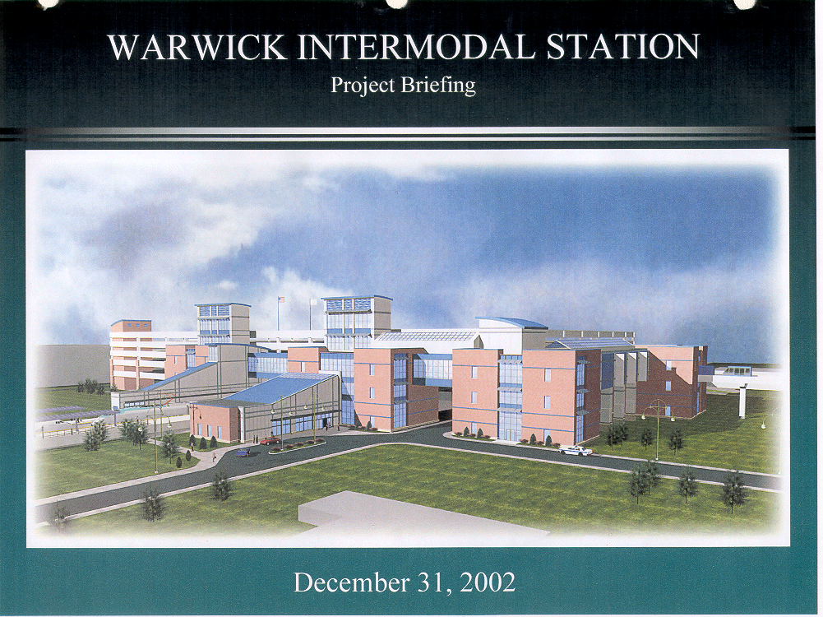
Keys to increasing ridership and to the IMO’s success
Lower fares: competition yields more choices and drives down ticket prices
Faster trips: high speed rail reduces trip-times
Increased frequencies: achieved through additional trains, new train operators, and upgraded and new infrastructure
Better access:
  New stations to address 21st century travel patterns
  Integrated with electric autonomous vehicles
  Assured parking availability making it easier and more advantageous for people to join the rail revolution
  Express trains to airports
Cheaper, faster, better rail connections
Big picture
  Generates more jobs
  Reduces highway congestion
  Diminishes climate change-inducing greenhouse gases
  Stimulates rail-induced economic development

Slide 28
To reach me…Ross Capon
rcapon3@gmail.com
301-385-6438
9220 Shelton St., Bethesda MD 20817-2410

